Slide 1
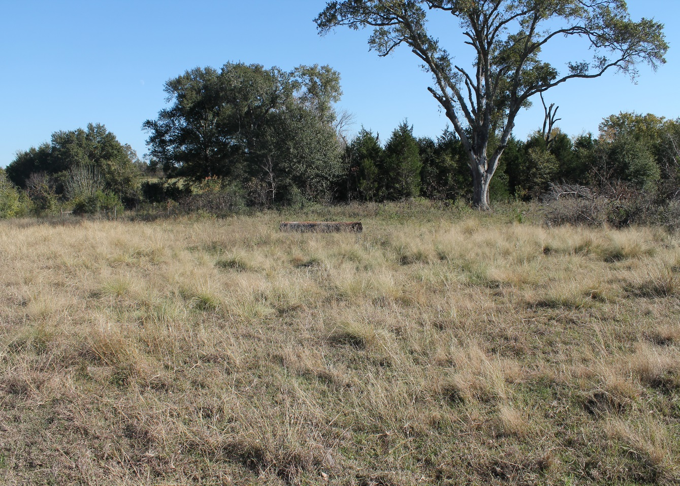

50.307 Acres
Shupak Road~Bellville Texas
Located just outside of Nelsonville and convenient to Bellville, Brenham and Industry, the property features views with several potential homesites. The land is rolling and sandy with good drainage. There is a seasonal creek bordered with Pecans. Electricity and a well are already in place.
Bellville Office
420 E Main
Bellville, Tx. 77418
979-865-5969
New Ulm Office
424 Cedar St.
New Ulm, Tx. 78950
979-992-2636

Slide 3
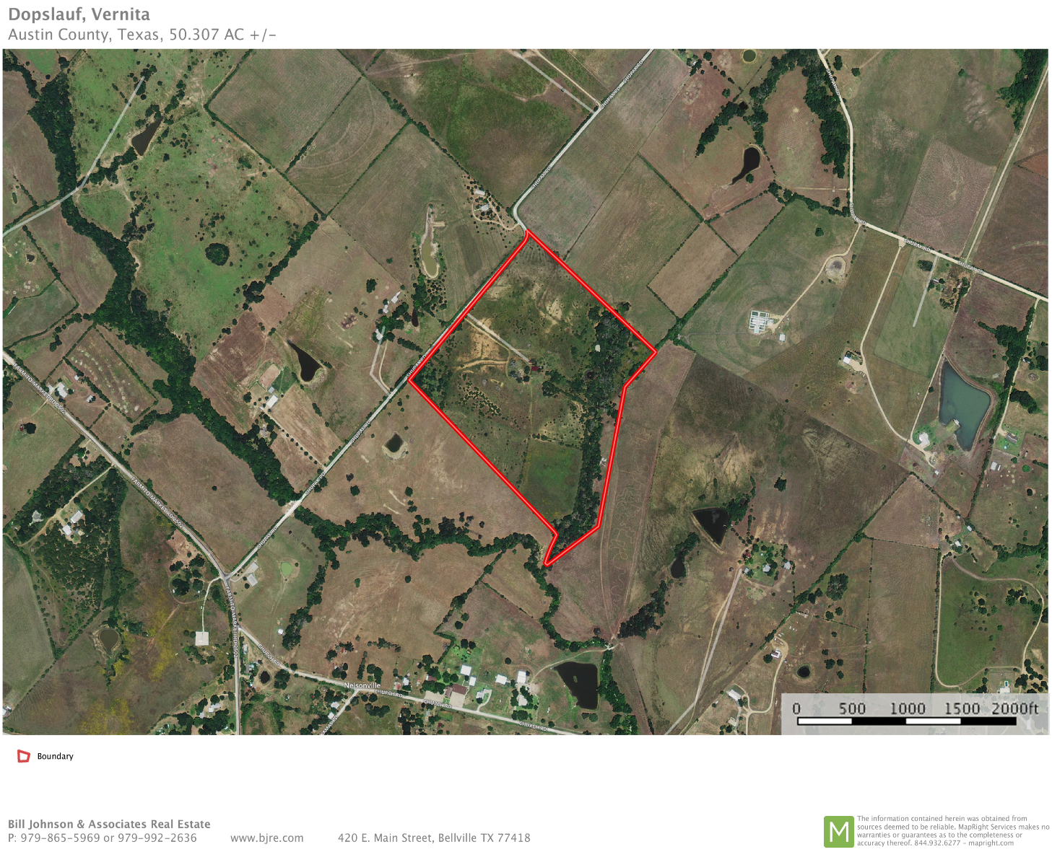
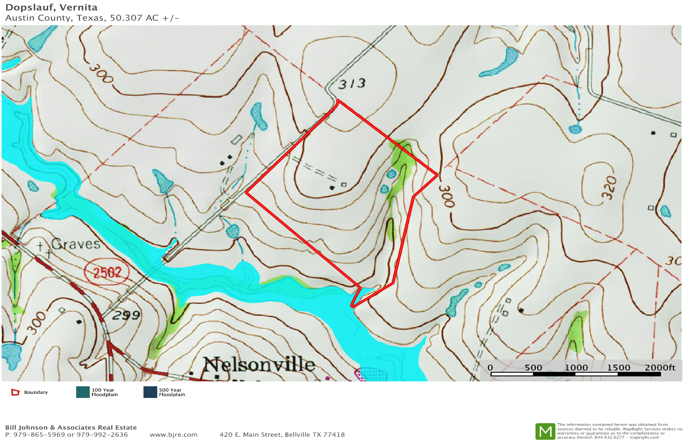

Slide 4
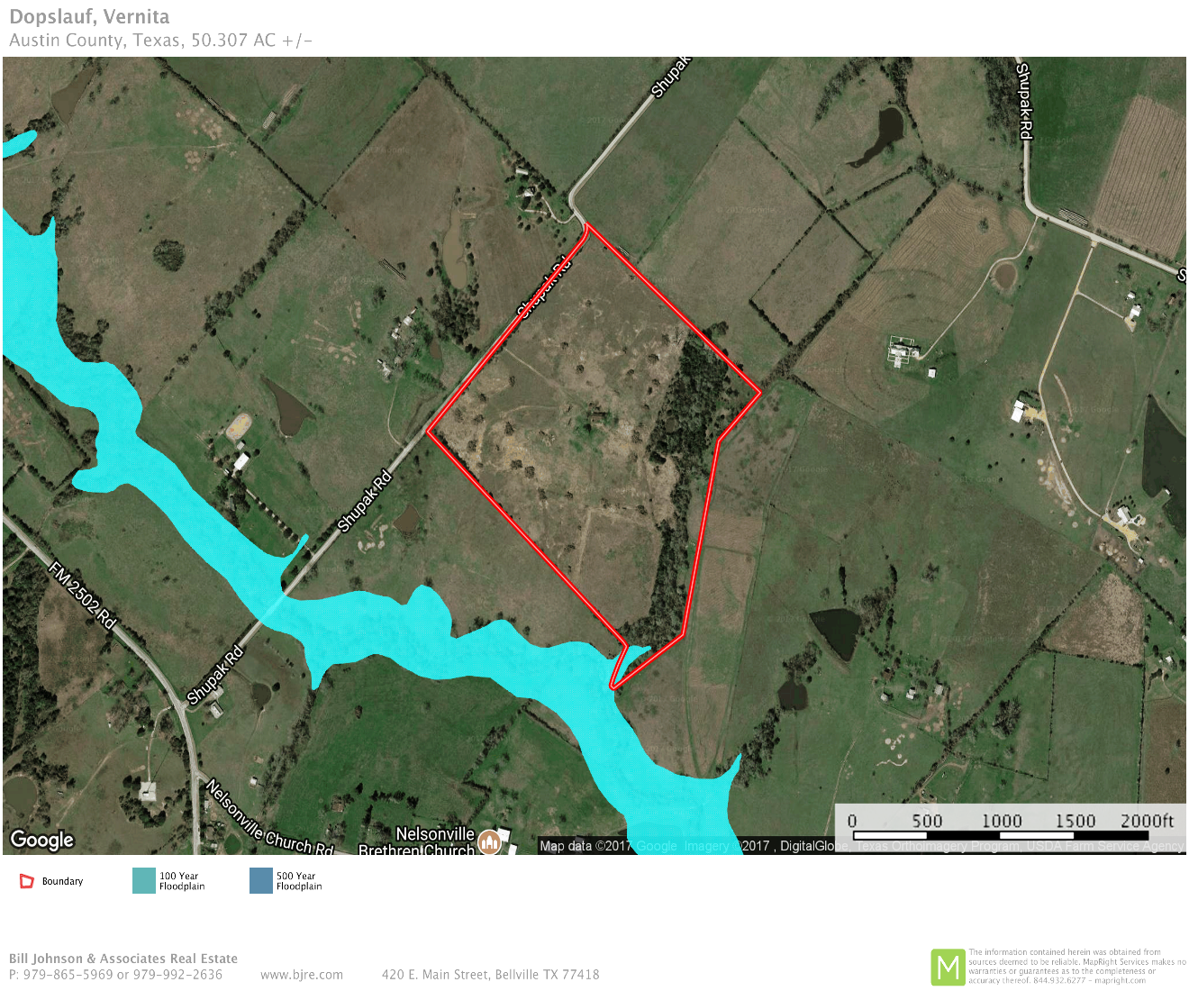
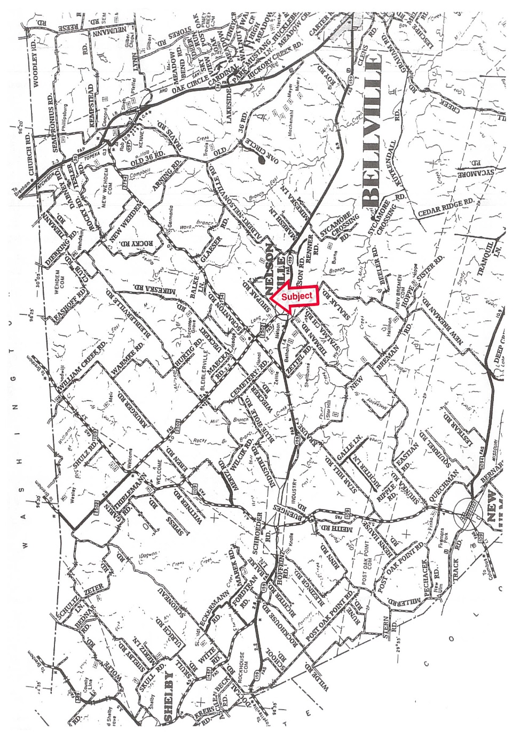

Slide 5
