Slide 1

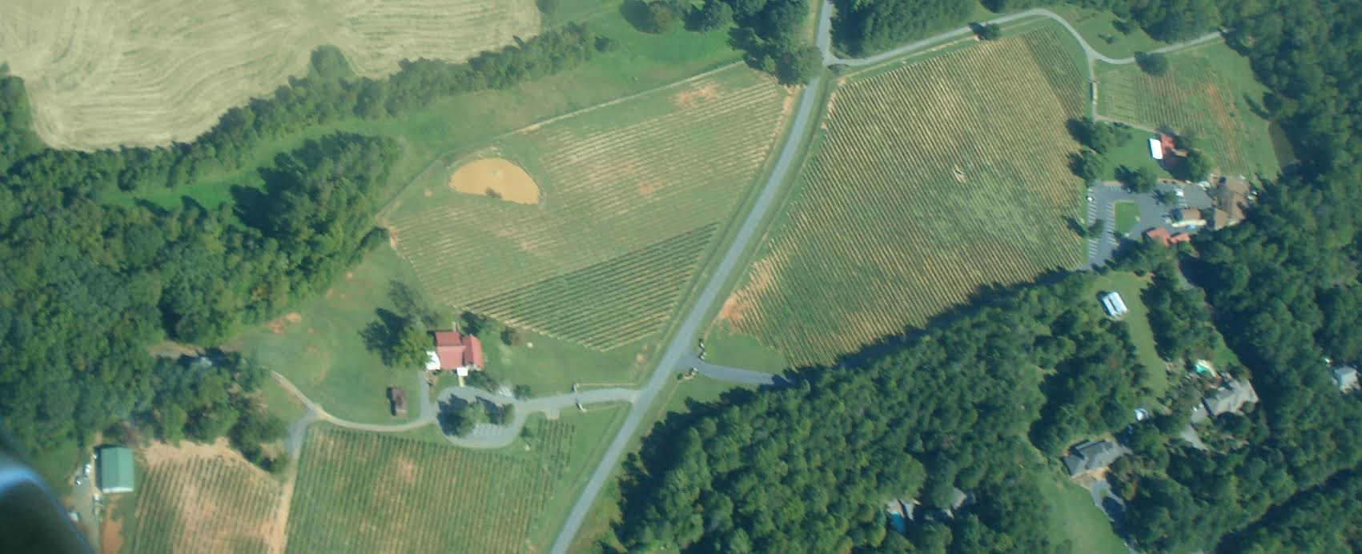
PRESENTS
WESTBEND

