Slide 1
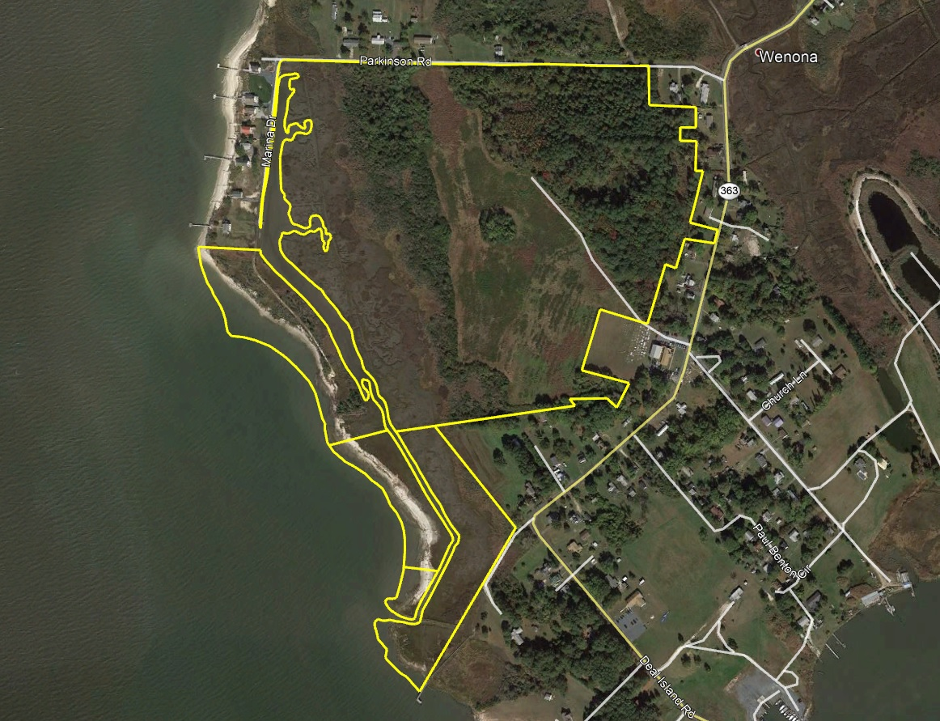
Wenona Waterfront Farm
Doug Williams
doug@thelandgroup.us
410-726-1831

Slide 2
Parkinson Road | Wenona, MD 21821
89
Somerset
$299,000
89+- acres located on the scenic Tangier Sound in Wenona MD. This tract is one of the largest private tracts on Deal Island with over 3,000' of waterfront on the Tangier Sound! Build your dream home with spectacular views across the Sound with sunsets to remember. Abundant wildlife with waterfowl and whitetail deer. 20+- acres of arable land, 28+- acres of timber and the remainder as tidal estuary with a private cove. Stabilized dirt road that leads out to the beach for unparalleled views. Put your boat over at one of the nearby ramps in Deal Island or Wenona or if you prefer to keep it overboard, slips are available at the marinas! Several deer stands and waterfowl blinds are on property. Freshwater pond is loaded with waterfowl. Purchase now as a recreational property and build later!
Doug Williams
doug@thelandgroup.us
410-726-1831

