Slide 1
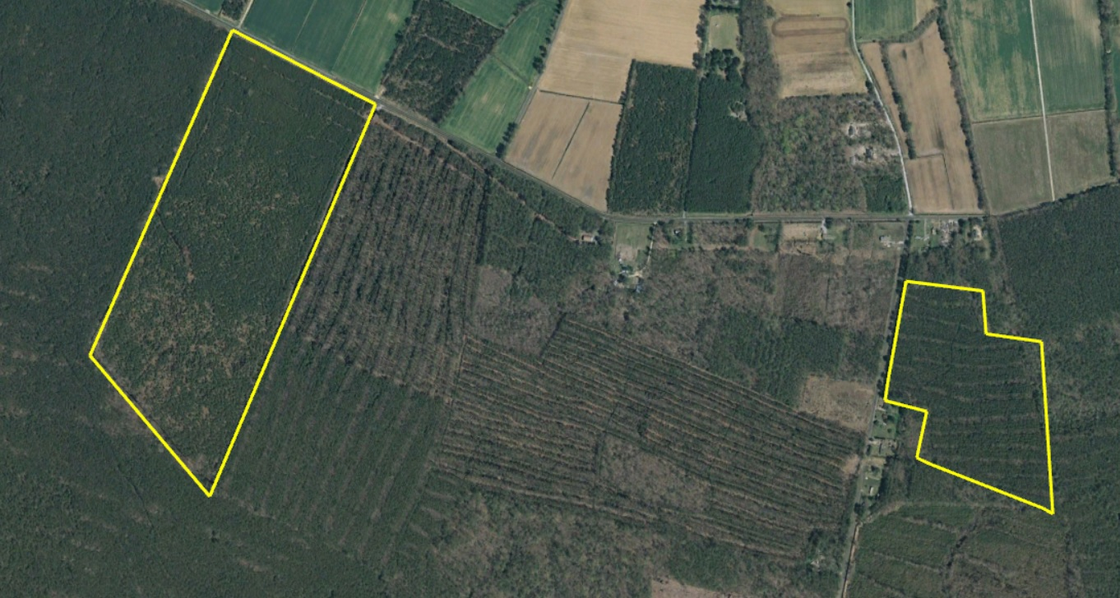
Wagenburg 8
Doug Williams
doug@thelandgroup.us
410-726-1831

Slide 2
New Road | Princess Anne, MD 21853
90.69
Somerset
$150,000
Wagenburg Parcel 8 is a well stocked plantation of pine with mixed
hardwoods. Located just West of Princess Anne. The tract is surrounded by
neighboring forest. Ideal property for deer and turkey hunting. There is an
existing hunt lease on the property that can be terminated or continued at
buyers discretion. Several urban centers are within a 2-3 hour drive of the
property: Zoning is AR agricultural-residential district. Property is in a
Forestland Conservation Easement. Two separate parcels sold together
totaling 90.69 +- acres.
Doug Williams
doug@thelandgroup.us
410-726-1831

