Slide 1
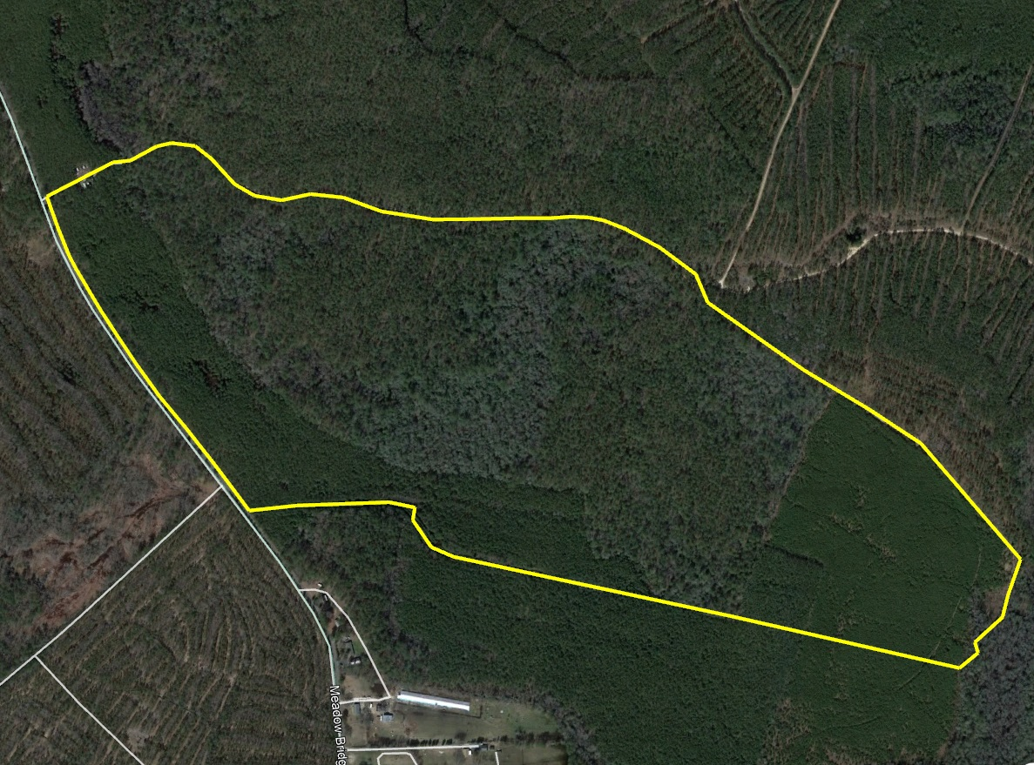
Meadow Bridge Lot 3
Meadow Bridge Road | Princess Anne, MD
Doug Williams
doug@thelandgroup.us
410-726-1831

Slide 2
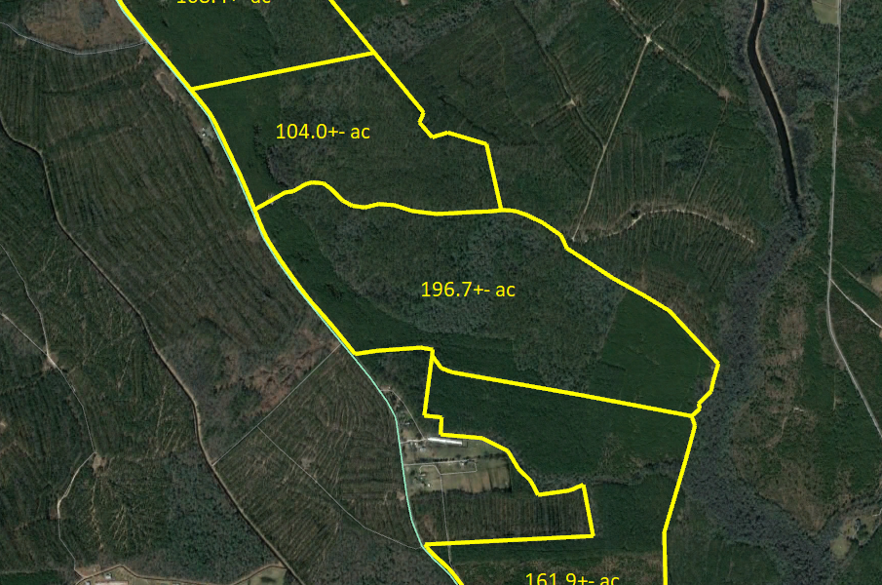
Meadow Bridge Lot 3 | Princess Anne, MD
196.7
Somerset
$1,750
$344,000
+/- 196.7 acres on Meadow Bridge Road in Princess Anne, MD. Property has no conservation easements. Well managed timber plantation with good trails and access throughout. Excellent hunting. Priced at $1,750 an acre, properties can be sold together or apart. Multiple configurations will be considered.
Doug Williams
doug@thelandgroup.us
410-726-1831

