Slide 1
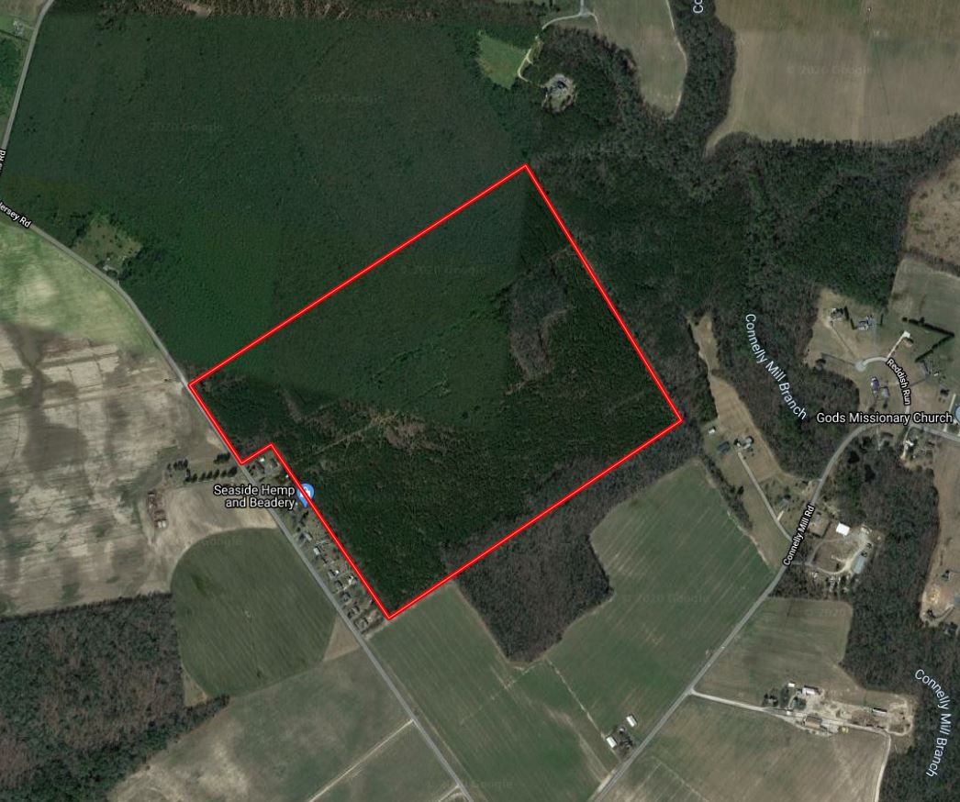
Hastings South Tract
Jersey Road | Delmar, MD 21875
Doug Williams
doug@thelandgroup.us
410-726-1831

Slide 2
Jersey Road | Delmar, MD 21875
123.67
Wicomico
$205,000
The Hastings South Tract is a well stocked plantation of hardwoods and pines. The tract is surrounded by neighboring forest and cropland. There is an existing hunt lease on the property that can be terminated or continued at buyer's discretion. Zoning is AR agricultural-residential district. Property is in a Forestland Conservation Easement. List price does not include building rights, which may be purchased for an additional fee.
Doug Williams
doug@thelandgroup.us
410-726-1831

