Slide 1


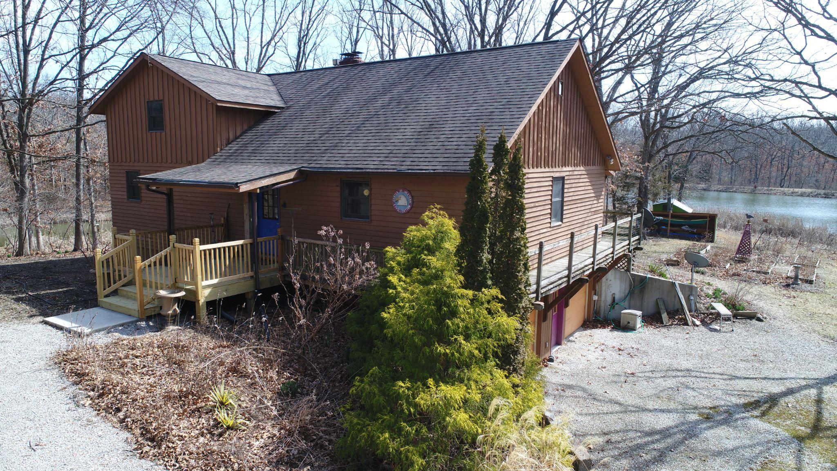
Melanie Morgret, Salesperson
United Country Land Pros LLC
19771 Highway 136
Memphis, MO 63555
Cell: 660-341-2373
Office: 660-465-2971
Fax: 660-465-2972
www.weknowdirt.net
managerlandpros@gmail.com
melaniemorgret75@gmail.com
Listing #: 24066-23012
List Price: $648,500
2 bed & 2.5 bath
30’X50’ Steel building
Sits on 80 acres
Mature trees
Well stocked lake
Walking/ utility vehicle trails
Located 2 miles off of Hwy 63
Just 20 minutes from Columbia

Slide 2
