Slide 1
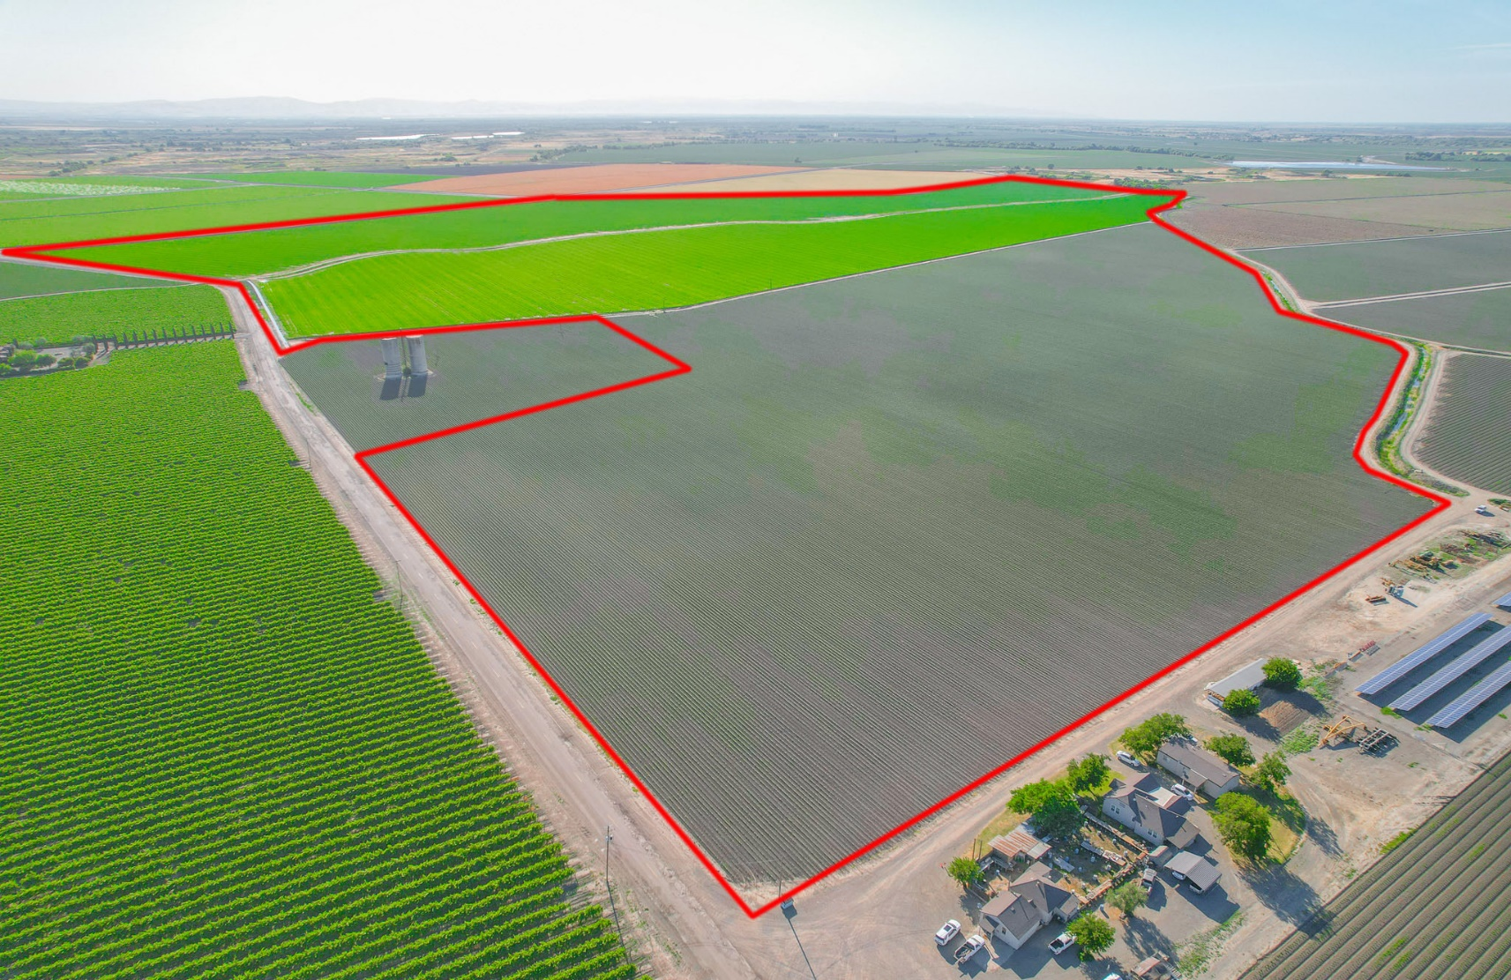


252.21 ± Acres For Sale
Open Farm Ground APNs: 073-080-013 10.60 ac 073-110-018 94.70 ac
073-110-023 37.35 ac
073-120-024 19.46 ac
073-120-025 90.10 ac
The offered parcels have
San Luis Canal Company Water Rights
Contact Me:
REALTOR® | DRE#01223541
(209) 587-0573
Geneva Brett
Associate Broker
GenevaBrett@gmail.com
Geneva-Brett.C21SelectGroup.com
The information contained in this brochure is from reliable sources. It is believed to be correct;
however, the information is NOT guaranteed. Conduct your own investigations.

Slide 2

Property Details
DESCRIPTION
252.21 ± assessed acres offered for sale has arguably the best water rights in California and features productive row crop ground. No structures on the property. Subject to ground lease expiring on 12/31/2024.
LOCATION
East of Hereford Road and the East Delta Canal, west of the Levee Drain, with Palazzo Road being the southern boundary. Situated northeast of Los Banos, Merced County, California.
LEGAL
Merced County APNs: 073-080-013, 073-110-018, 073-110-023, 073-120-024, 073-120-025. All parcels enrolled in Williamson Act. Note – 9.2 ± ac (APN 073-120-003) being farmed in Field 3 is not owned nor offered for sale.
ZONING
A-20, General Agriculture
PLANTINGS
Field 1 (107± acres) and Field 2 (81 ± ac) are currently in alfalfa (2nd year). Field 3 (73 ±ac) in cotton. There is a 9.2 acre parcel being farmed in Field 3 that is not owned by Seller. Lessee said alfalfa averaged 5.5-6 tons per acre for the last two years.
WATER
252.21 shares, and irrigation water from San Luis Canal Company (SLCC), delivered via Henry Miller Reclamation District (HMRD). SLCC was incorporated and began service in 1913. The company claims and continues to hold Pre-1914 appropriative water rights and historically provided water to its members during the toughest drought years. County of Merced GSA – Delta-Mendota (Service Area).
SOILS
Grade 3, Bisgani loamy sand, Bolfar clay loam, Einido clay loam, Escano clay loam; all partially drained.
GROUND WATER DISCLOSURE
The Sustainable Groundwater Management Act (SGMA) requires groundwater basins to be sustainable by 2040. SGMA requires a Groundwater Sustainability Plan (GSP) by 2020. Said plans may limit ground water pumping.
For more information, please visit the SGMA website at www.sgma.water.ca.gov/portal/
PRICE/TERMS
$26,000./acre. ($6,557,460). Seller may participate in 1031 Exchange at no cost to Buyer. No owner financing.
Geneva Brett
REALTOR® | DRE#01223451
(209) 587-0573
Geneva-Brett.C21SelectGroup.com
1155 E. Pacheco Blvd, Los Banos
GenevaBrett@gmail.com
The information contained in this brochure is from reliable sources. It is believed to be correct;
however, the information is NOT guaranteed. Conduct your own investigations.

Slide 3
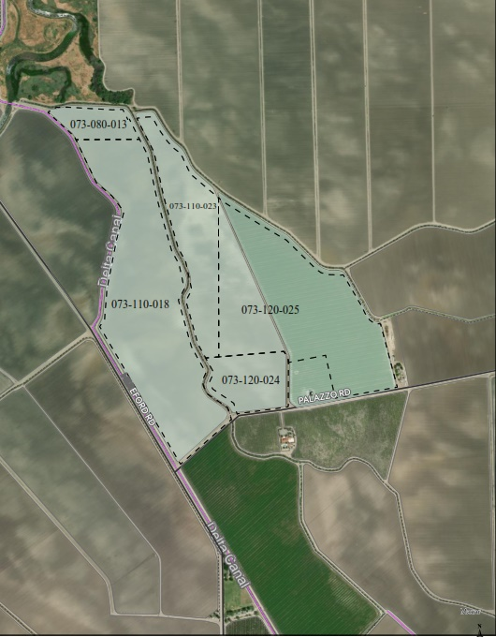
Parcel Map
9.2± ac farmed/not owned
Geneva Brett
REALTOR® | DRE#01223451
(209) 587-0573
Geneva-Brett.C21SelectGroup.com
1155 E. Pacheco Blvd, Los Banos
GenevaBrett@gmail.com
The information contained in this brochure is from reliable sources. It is believed to be correct;
however, the information is NOT guaranteed. Conduct your own investigations.

Slide 4
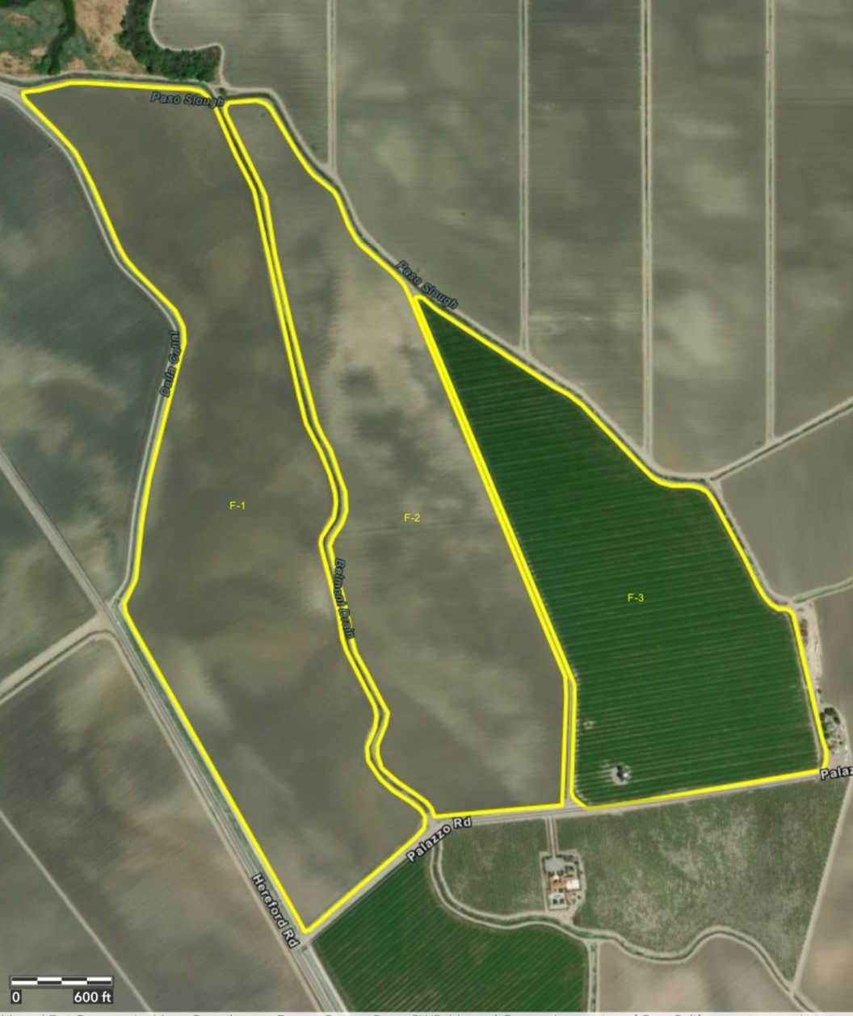
Farmed Fields and Acreage
107 Field Acres
Crop 1- Alfalfa
Field 1
81.2 Field Acres
Crop 1 – Alfalfa
Field 2
73.7 Field Acres
Crop 1 – Cotton-pima
Field 3
9.2± ac farmed/not owned
Geneva Brett
REALTOR® | DRE#01223451
(209) 587-0573
Geneva-Brett.C21SelectGroup.com
1155 E. Pacheco Blvd, Los Banos
GenevaBrett@gmail.com
The information contained in this brochure is from reliable sources. It is believed to be correct;
however, the information is NOT guaranteed. Conduct your own investigations.

Slide 5
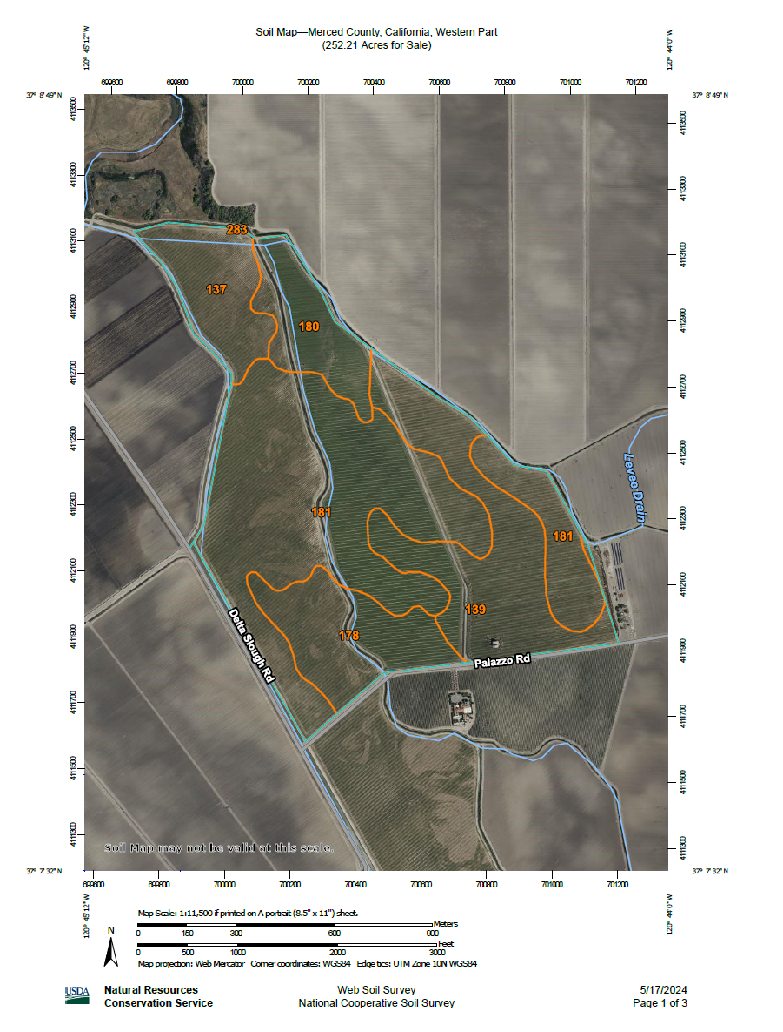
USDA Soils Map

Slide 6
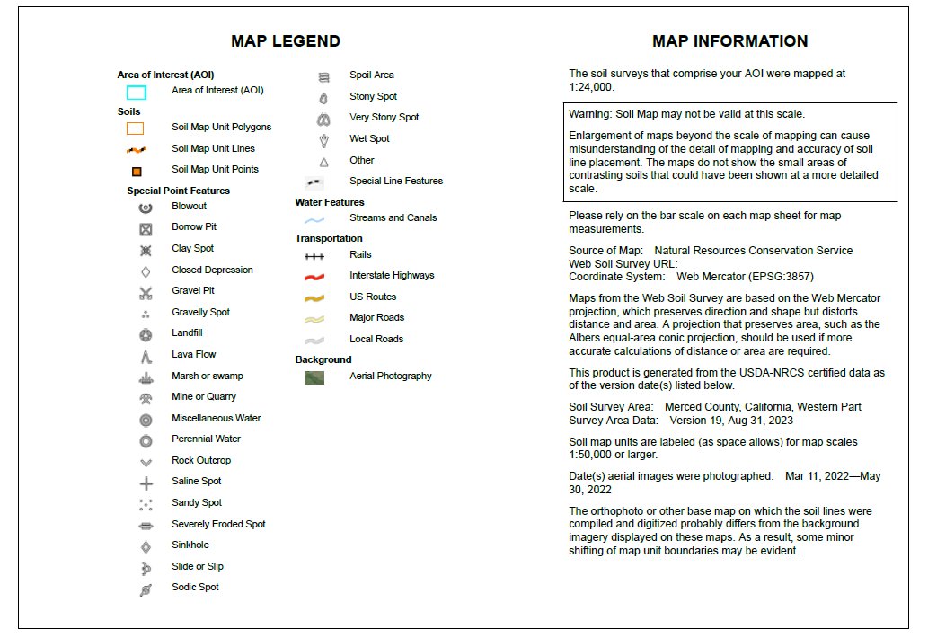
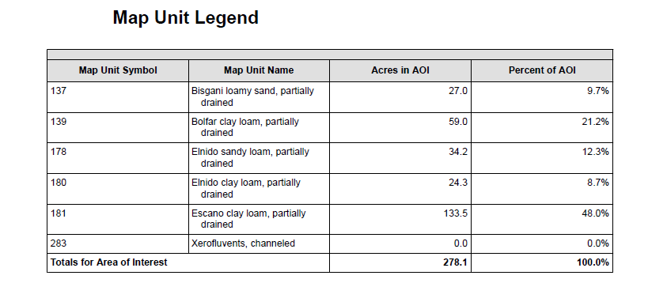
Soils Map Legend, Map Information and Map Unit Legend
Geneva Brett
REALTOR® | DRE#01223451
(209) 587-0573
Geneva-Brett.C21SelectGroup.com
1155 E. Pacheco Blvd, Los Banos
GenevaBrett@gmail.com
The information contained in this brochure is from reliable sources. It is believed to be correct;
however, the information is NOT guaranteed. Conduct your own investigations.

Slide 7
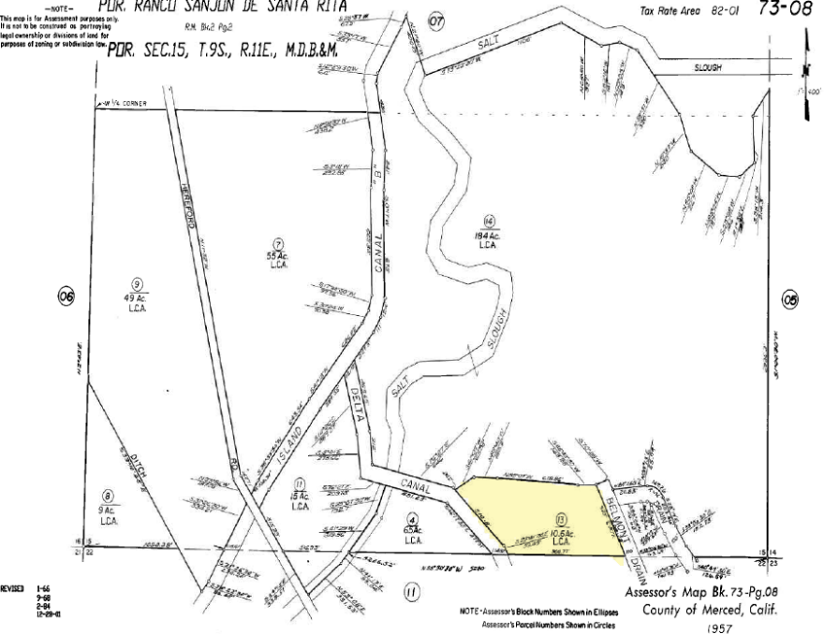
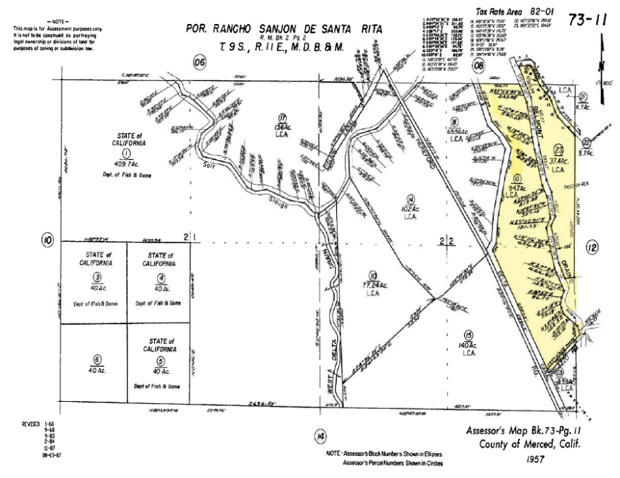
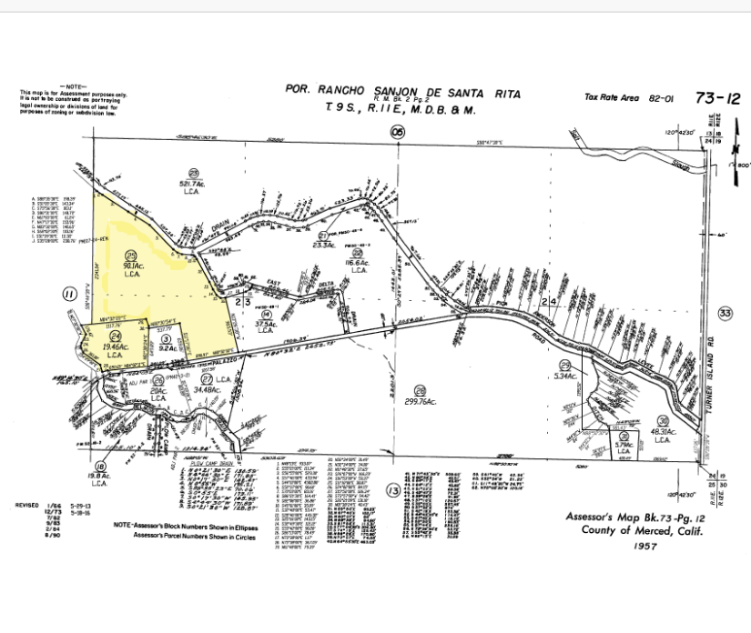
Plat Maps
Assessor’s Parcel Numbers
073-080-013 10.60 ac
073-110-018 94.70 ac
073-110-023 37.35 ac
073-120-024 19.46 ac
073-110-025 90.10 ac 252.21 ac
Geneva Brett
REALTOR® | DRE#01223451
(209) 587-0573
Geneva-Brett.C21SelectGroup.com
1155 E. Pacheco Blvd, Los Banos
GenevaBrett@gmail.com
The information contained in this brochure is from reliable sources. It is believed to be correct;
however, the information is NOT guaranteed. Conduct your own investigations.

Slide 8
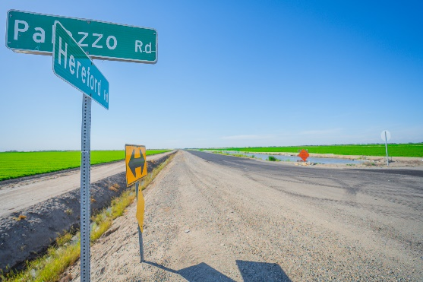
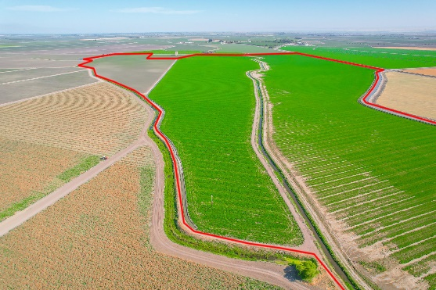
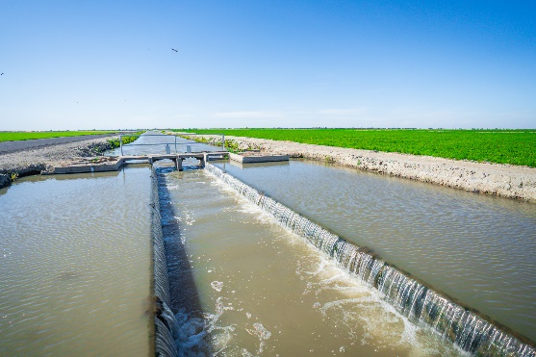
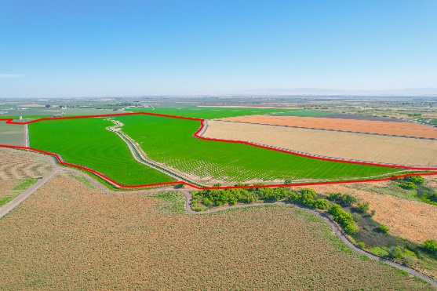
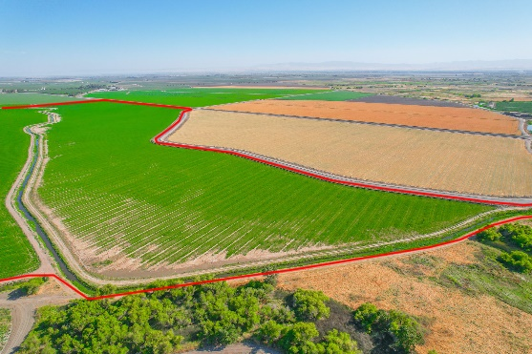
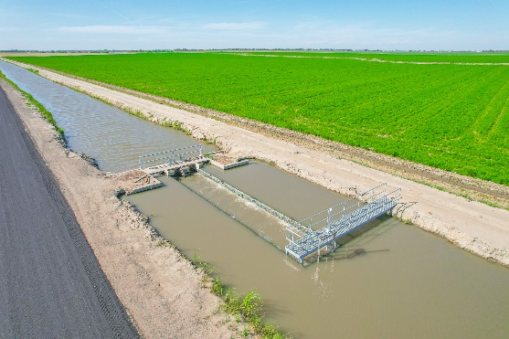
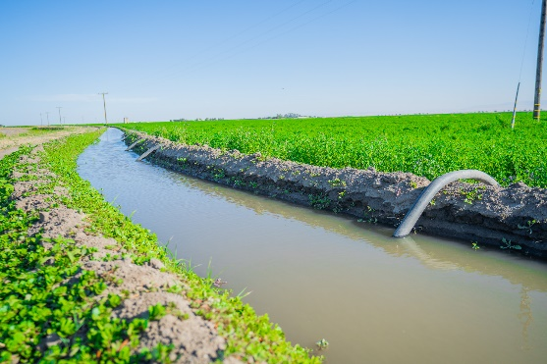
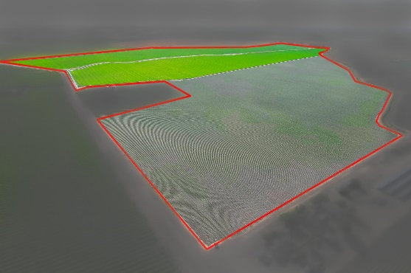
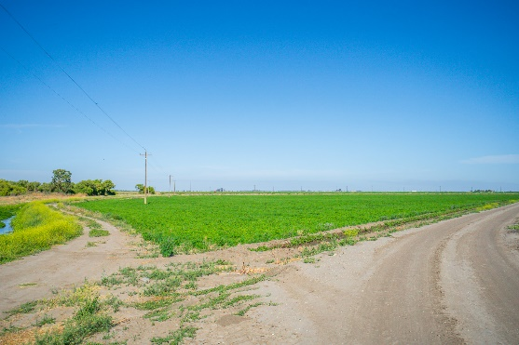
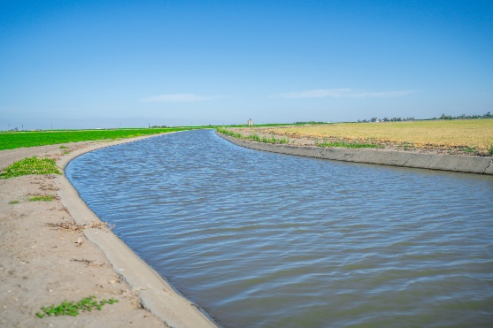

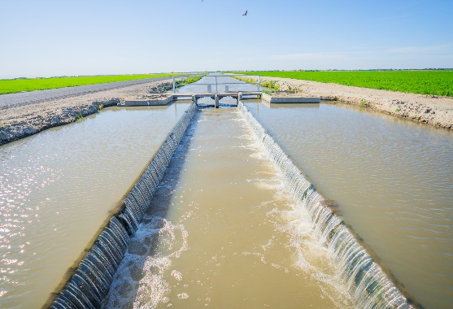
Photos
Geneva Brett
REALTOR® | DRE#01223451
(209) 587-0573
Geneva-Brett.C21SelectGroup.com
1155 E. Pacheco Blvd, Los Banos
GenevaBrett@gmail.com
The information contained in this brochure is from reliable sources. It is believed to be correct;
however, the information is NOT guaranteed. Conduct your own investigations.

Slide 9
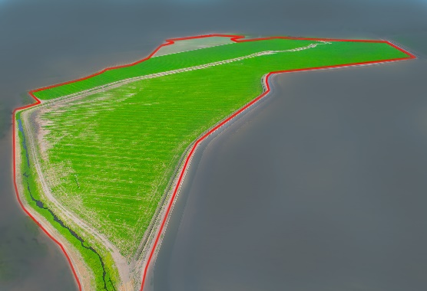
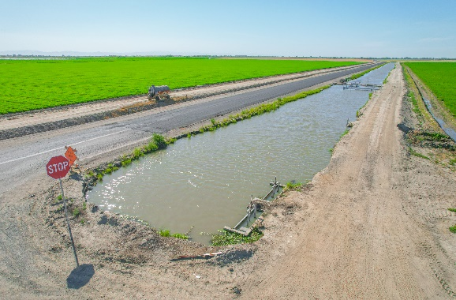
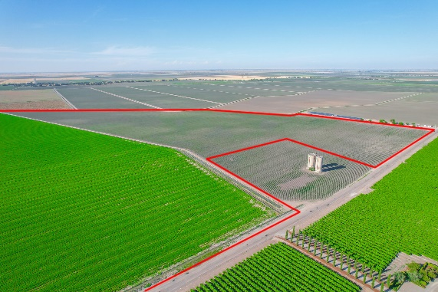
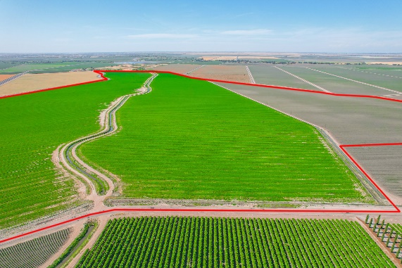
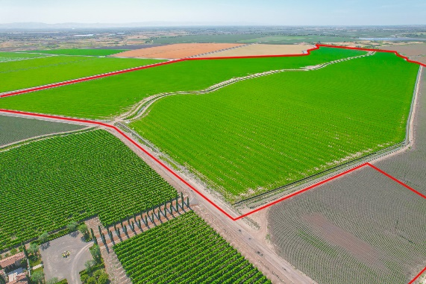
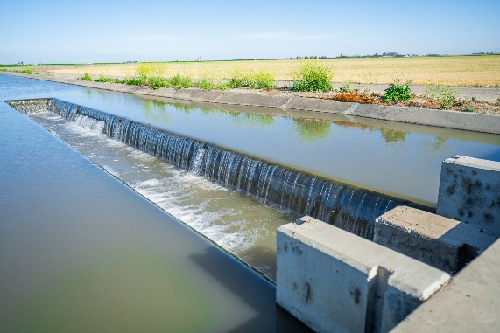
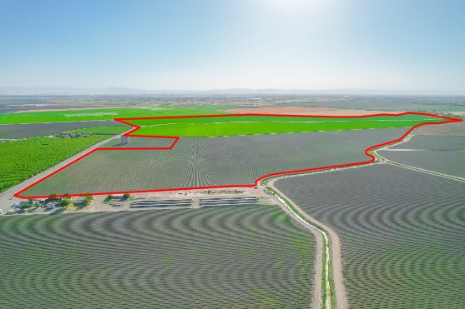
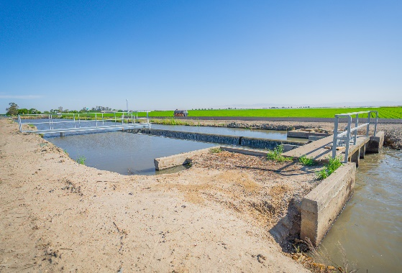
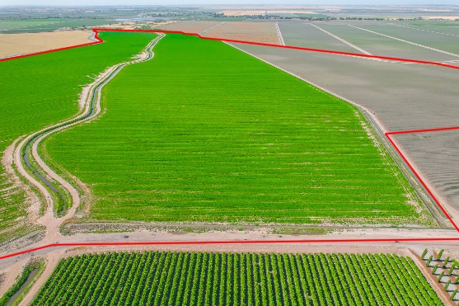
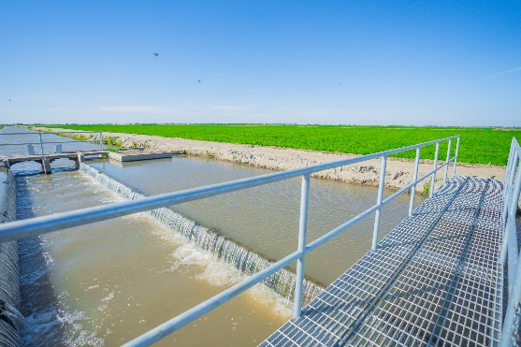
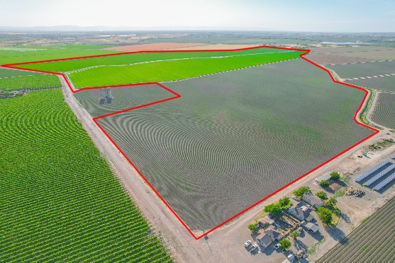
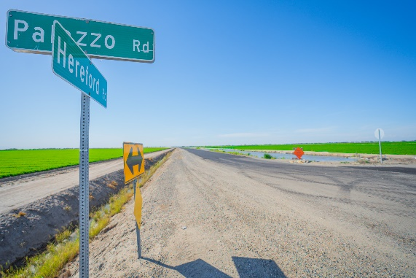
Photos
Geneva Brett
REALTOR® | DRE#01223451
(209) 587-0573
Geneva-Brett.C21SelectGroup.com
1155 E. Pacheco Blvd, Los Banos
GenevaBrett@gmail.com
The information contained in this brochure is from reliable sources. It is believed to be correct;
however, the information is NOT guaranteed. Conduct your own investigations.

Slide 10
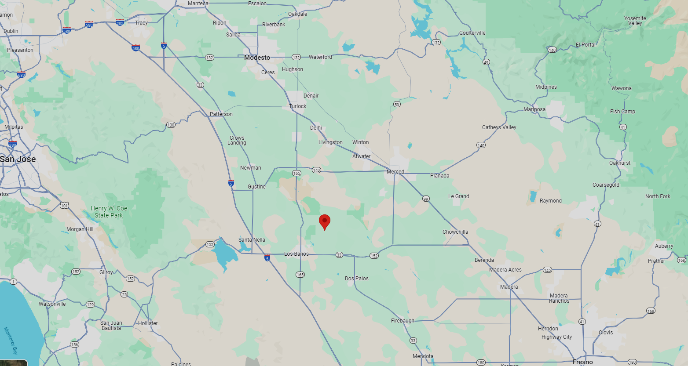

Location Map
252.21 ± Acres
NEC of Hereford and Palazzo Roads
Los Banos, CA
Water Disclosure: The Sustainable Groundwater Management Act (SGMA) requires groundwater basins to be sustainable by 2040. SGMA requires a Groundwater Sustainability Plan (GSP) by 2020. As a result, a limit may be placed on groundwater pumping from underground aquifers. Buyers and tenants to a real estate transaction should consult with their own water attorney; hydrologist; geologist; civil engineer; or other environmental professional. More information is available at the California Department of Water Resources Sustainable Groundwater Management Act Portal – www.sgma.water.ca.gov/portal Or call (916) 653-5791 Policy on cooperation: All real estate licensees are invited to offer this property to prospective buyers.
Geneva Brett
REALTOR® | DRE#01223451
(209) 587-0573
Geneva-Brett.C21SelectGroup.com
1155 E. Pacheco Blvd, Los Banos
GenevaBrett@gmail.com
The information contained in this brochure is from reliable sources. It is believed to be correct;
however, the information is NOT guaranteed. Conduct your own investigations.

