Slide 1

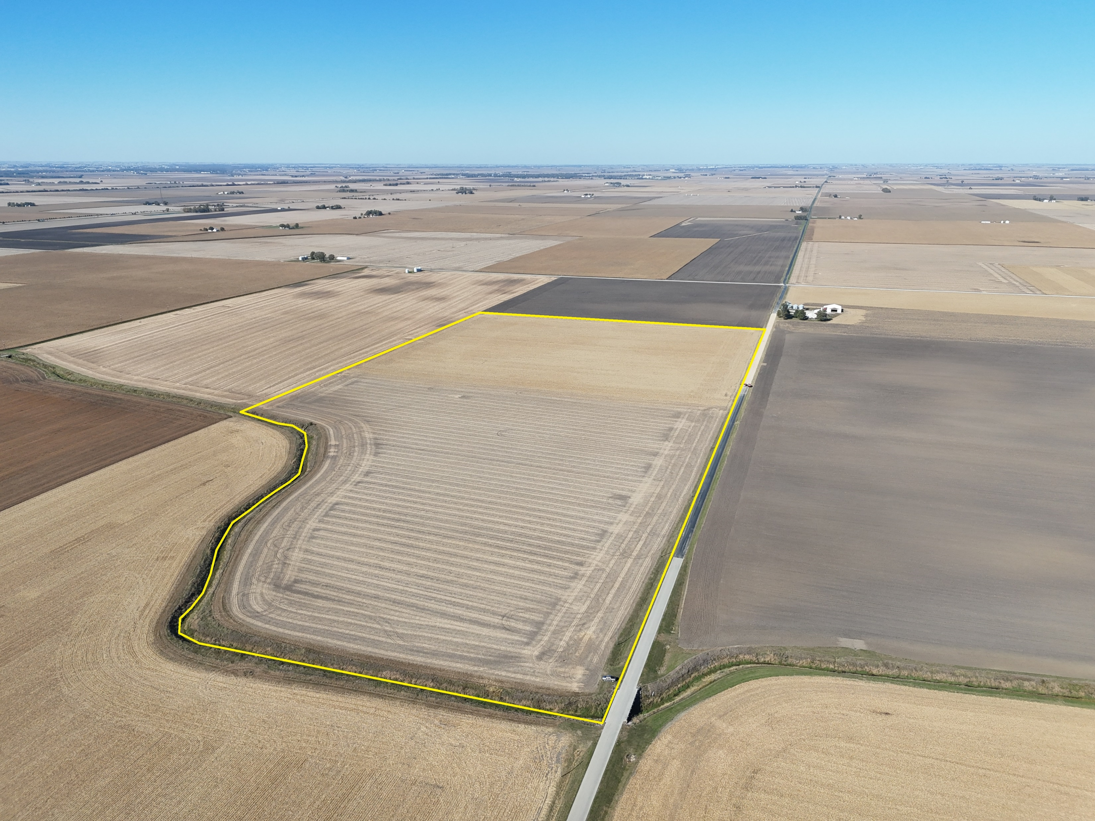






Farr Farm
Timed Online Farmland Auction
December 6th | 10:00 AM Soft Close
69.49 +/- Surveyed Acres | 1 Tract
Coles County | Humboldt Township
Broker | Michael Lauher
217-345-8312
michael.lauher@firstmid.com
1317 Charleston Ave.
Mattoon, IL 61938
Lic. 471.019588
Auctioneer | Justin Wheeler
217-855-8358
jwheeler@firstmid.com
455 North Main Street
Decatur, IL 62523
Lic. 441.002548
Appraisals | Auctions | Brokerage | Crop Insurance | Farm Management

Slide 2

Farr Farm | Coles County | Farmland Auction
General Information
SELLER: James & Sheri Farr
DESCRIBED AS: 69.49 +/- real estate surveyed acres in Section 2, Humboldt Township, Coles County, IL
Legal Descriptions can be found on page 10.
LOCATION: 3 miles east of Humboldt, IL
Located ¼ mile north of County Road 16 (1500N) on the west side of N County Rd 1100E
TIME AND PLACE Soft Close 10:00 AM – Friday, December 6th, 2024
OF AUCTION: Timed Online Only Auction
ONLINE BIDDING: Bid anytime from November 22nd through 10 AM December 6th, subject to a soft close, at https://firstmidag.bidwrangler.com or download the First Mid Ag App from the App store on your mobile device!
AGENCY: Justin Wheeler, Auctioneer, and Michael Lauher, Managing Broker, are designated agents with First Mid Ag Services, a Division of First Mid Wealth Management and represent only the Seller in this transaction.
Disclosures and Disclaimer: The information provided is believed to be accurate and representative. The property is being sold on an “AS IS, WHERE IS” basis, and no warranty or representation, either express or implied, concerning the property is made by the Seller or the auction company. All information contained in all related materials is subject to the terms and conditions outlined in the purchase agreement. Each potential bidder is responsible for conducting his/her own independent inspections, investigations, inquiries, and due diligence concerning the property. The information contained here is believed to be accurate but is subject to verification by all parties relying on it. All sketches and dimensions are approximate. By bidding on the real estate, the Buyer agrees that Buyer has had ample opportunity to inspect the property. This sale may not be recorded and/or videotaped without the permission of the auctioneer. Seller and Seller’s agent disclaim any and all responsibility for Bidder’s safety during any physical inspection of the property. No party shall be deemed an invitee of the property by virtue of the offering of this property for sale. Conduct of the auction and increments of bidding are at the direction and discretion of the Auctioneer. All announcements day of sale will take precedence over printed material. The Auction Company and Sellers reserve the right to preclude any person from bidding if there is any question as to the person’s credentials or fitness to bid. Announcements will be allowed on auction day ONLY with prior approval from First Mid Ag Services. While this farm is being offered with reserve, we do anticipate a sale of the property.
Bloomington | Decatur | Kankakee Mattoon | Peoria | Springfield
www.firstmidag.com

Slide 3

Farr Farm | Coles County | Farmland Auction
Terms & Conditions
SALE METHOD: This is a TIMED ONLINE ONLY AUCTION. Bids can be made online to First Mid Ag Services at https://firstmidag.bidwrangler.com from November 22nd to December 6th with a soft close at 10:00 AM. No further bidding will be accepted after the bidding deadline is concluded. For example, if a bid is received at 9:59 AM, the clock will extend for 3 additional minutes until there is a 3-minute interval with no bids after 10:00 AM.
No Buyer’s Premium is being charged.
Online bidding is conducted at https://firstmidag.bidwrangler.com/ui or download the First Mid Ag App from the App store on your mobile device!
CONTRACT: Buyer will enter into a contract on date of sale with 10% down payment due at Allied Capital Title in Charleston, IL by 4:00 PM on December 9th , 2024, and the balance due at closing, which shall occur on or before January 6th, 2024. All property will be sold “as is, where is”, based on surveyed acres. Bidding is calculated by your bid price times the acres being sold and subject to Seller’s confirmation.
FINANCING: Bidding is not conditional upon financing, or any buyer or lender inspections. Be certain you have arranged financing, if needed, and are capable of paying cash at closing.
TITLE: Title policy in the amount of the sale price, subject to standard and usual exceptions, to be furnished by the Seller to the Buyer.
LEASE: There is open tenancy for the 2025 crop year.
WIND LEASE: There is no Wind Lease Agreement on this farm.
POSSESSION: Seller will grant full possession at closing, subject to the tenant’s rights that terminated with the harvest of the 2024 crop.
MINERAL RIGHTS: The owner’s remaining interest, if any, will be conveyed with the land.
REAL ESTATE The 2024 Real Estate Taxes payable in 2025 shall be paid by the Seller via a credit at closing
TAXES: based upon the most recent real estate tax information available. The 2025 real estate taxes payable in 2026 and all subsequent years will be the Buyer’s responsibility. No adjustments will be made after closing.
Bloomington | Decatur | Kankakee Mattoon | Peoria | Springfield
www.firstmidag.com

Slide 4
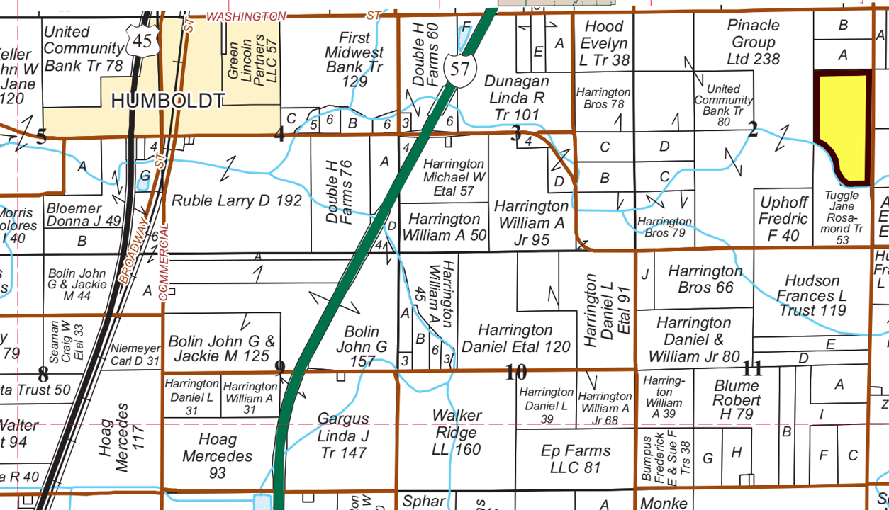
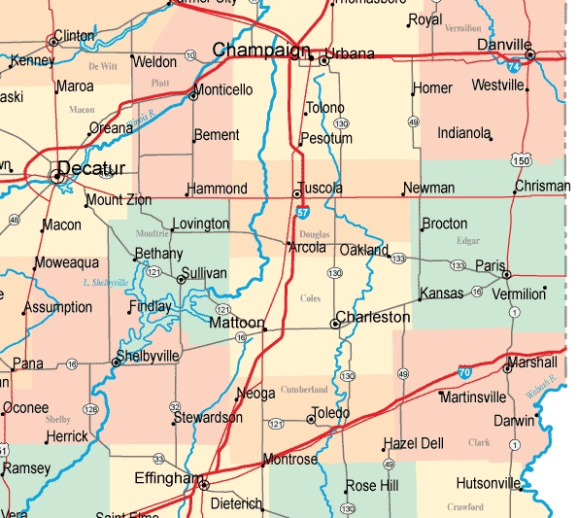
Farr Farm | Coles County | Farmland Auction
Area Maps
Coles Co. – Humboldt Twp T.13N.-R.8E.
Co Rd 16 (1500N)
N Co Rd 1100E
For Sale
For Sale
Bloomington | Decatur | Kankakee Mattoon | Peoria | Springfield
www.firstmidag.com

Slide 5
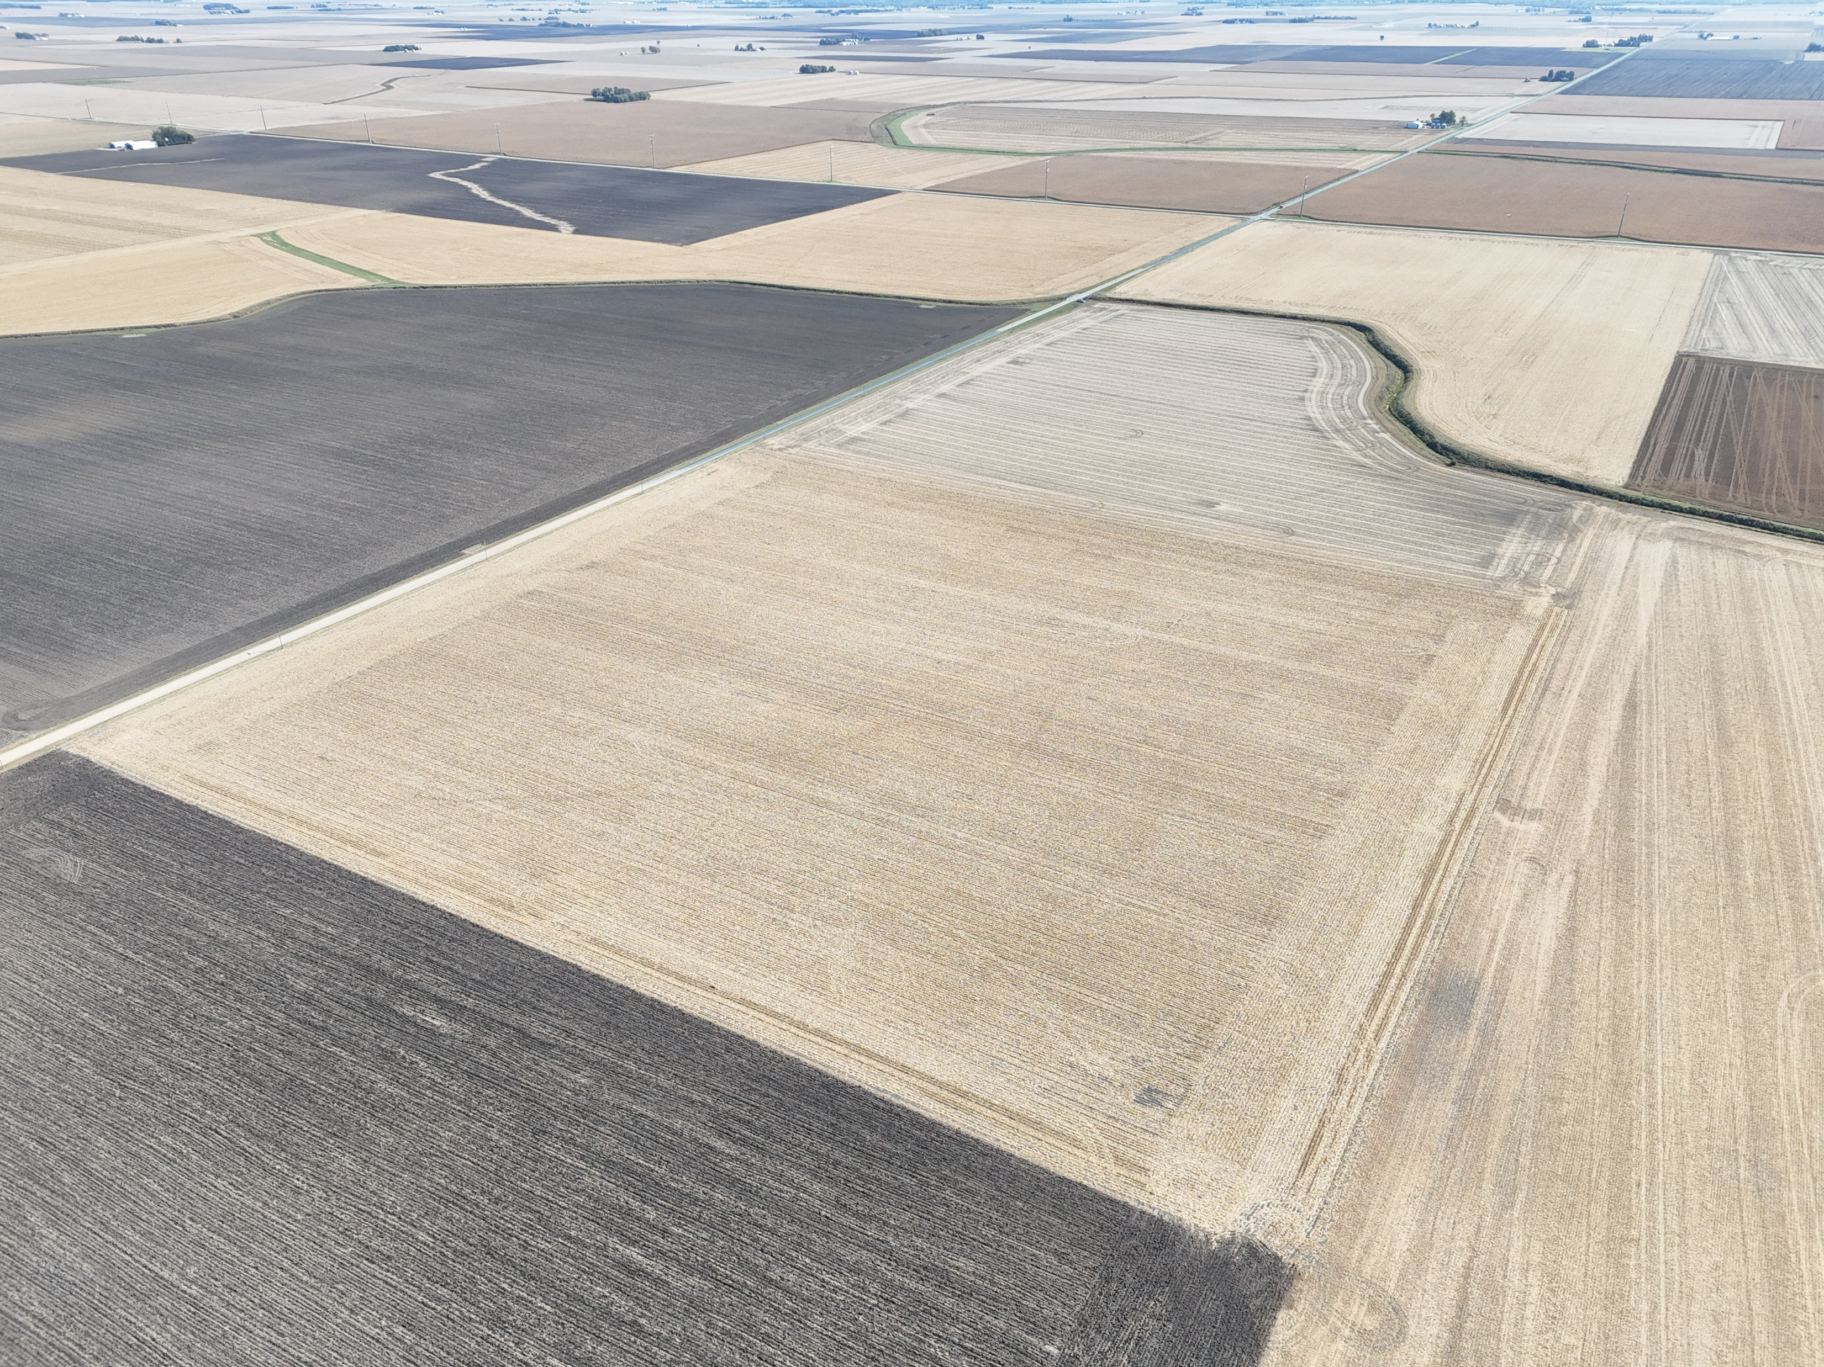
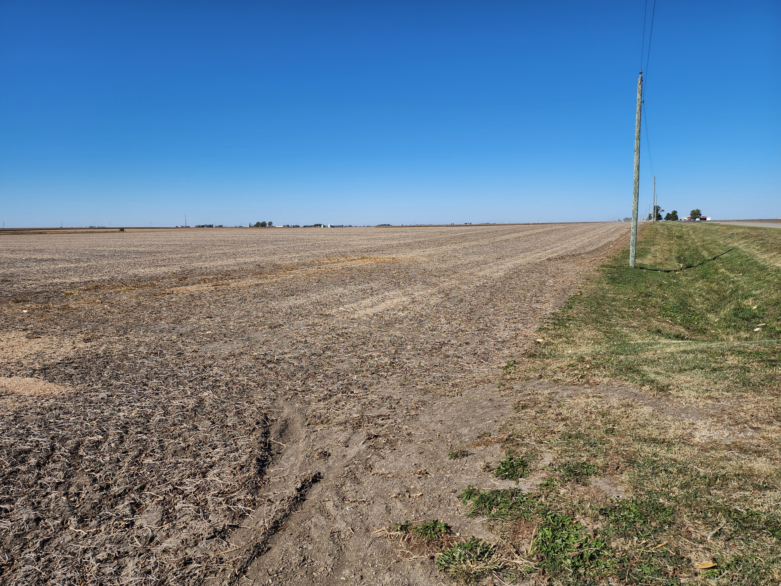
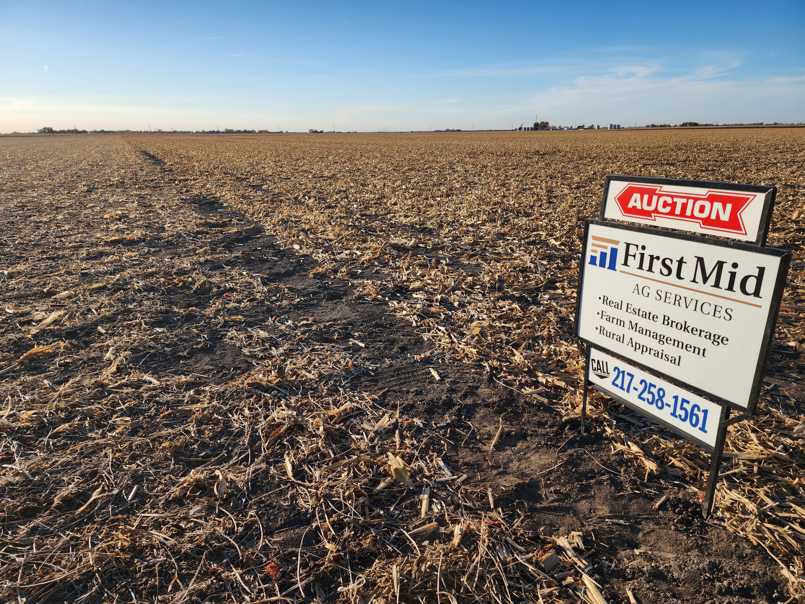
Farr Farm | Coles County | Farmland Auction
Photographs
Bloomington | Decatur | Kankakee Mattoon | Peoria | Springfield
www.firstmidag.com

Slide 6
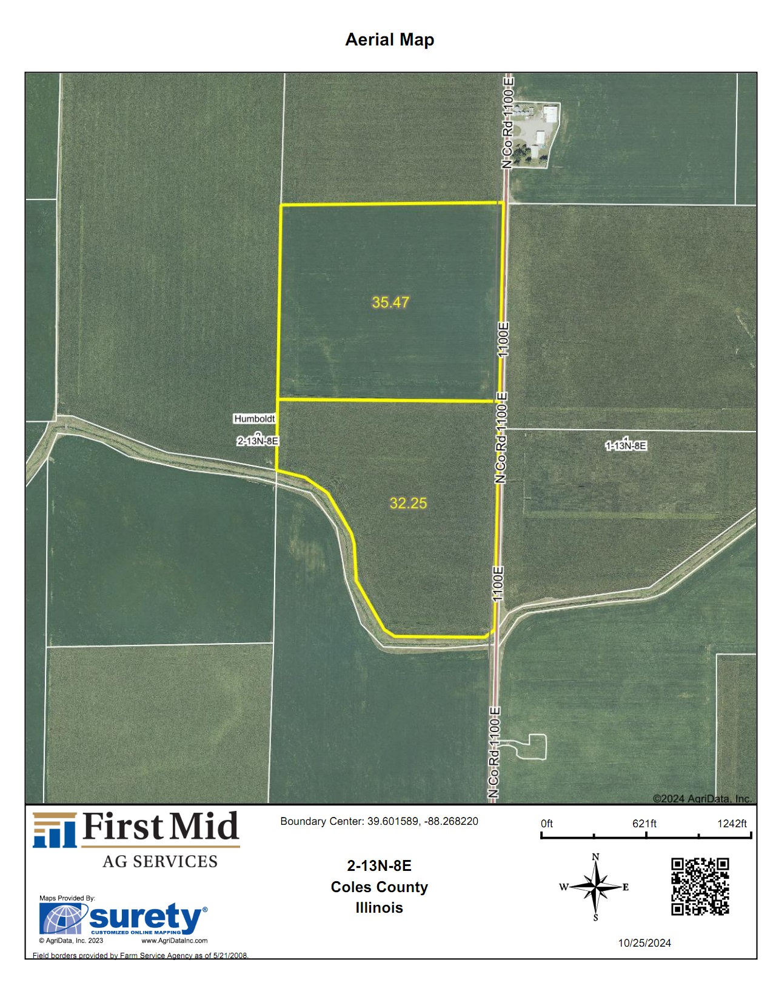
Farr Farm | Coles County | Farmland Auction
Aerial Map
Bloomington | Decatur | Kankakee Mattoon | Peoria | Springfield
www.firstmidag.com

Slide 7
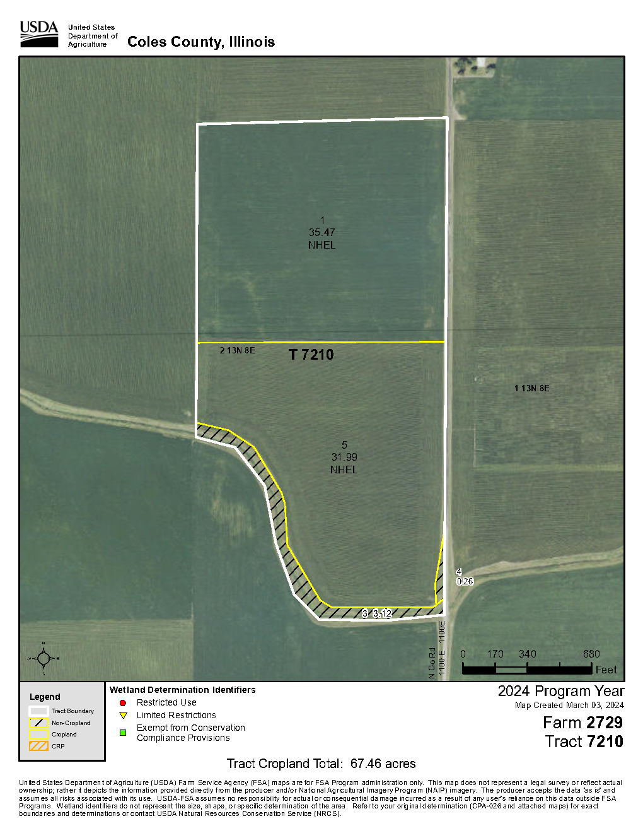
Farr Farm | Coles County | Farmland Auction
FSA Tract Map
T1
Bloomington | Decatur | Kankakee Mattoon | Peoria | Springfield
www.firstmidag.com

Slide 8
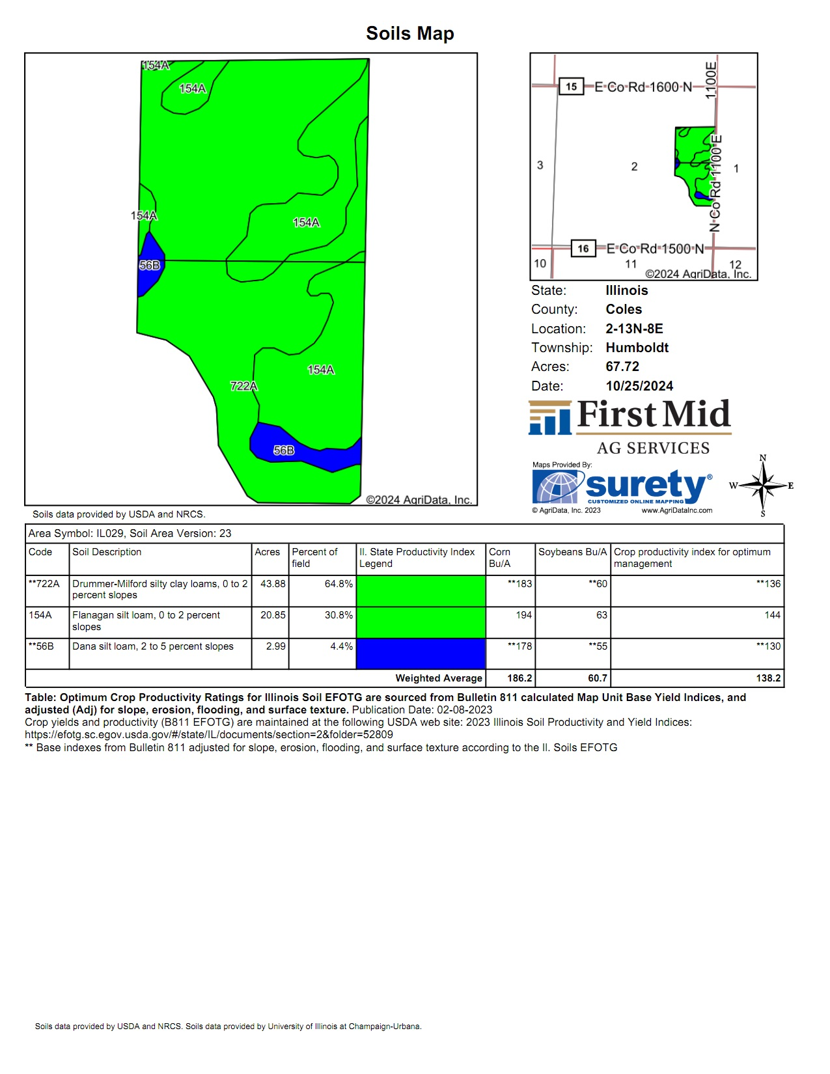
Farr Farm | Coles County | Farmland Auction
Soils Map
67.46 Est Tillable Acres 138.2 Average Soil PI
Bloomington | Decatur | Kankakee Mattoon | Peoria | Springfield
www.firstmidag.com

Slide 9
Farr Farm | Coles County | Farmland Auction
Real Estate Tax & FSA Information
Real Estate Tax Information
Parcel # | Tax Acres | Total Assessment | 2023 Taxes Paid 2024
04-0-00028-000 | 63.59 | 41,233 | $3,295.68
FSA Information
FSA # | 2729
TRACT # | 7210
HEL (Highly Erodible) STATUS | NHEL
WETLAND STATUS | Determination not complete
FSA FARMLAND ACRES | 70.84
DCP CROPLAND ACRES | 67.46
CORN BASE ACRES | 33.50
PLC YIELD CORN | 172
SOYBEAN BASE ACRES | 33.5
PLC YIELD SOYBEANS | 54
CORN PROGRAM ELECTION | ARC County
SOYBEAN PROGRAM ELECTION | Price Loss Coverage
Source: Coles Co, Illinois USDA FSA Office.
Soil Fertility Tests
Test Date | Tested Acres | P #/a | K #/a | pH
4/11/2020 | 35.5 | 86.3 | 426.2 | 6.0
4/11/2020 | 32.2 | 116.3 | 499.2 | 6.3
Yield History (bu/ac)
Year | Corn | Soybean
2024 | 215.21 | 78.04
2023 | 240.28 | 78.39
2022 | 237.49 | 71.28
2021 | 242.22 | 78.32
2020 | 211.28 | 72.17
AVG | 229.30 | 75.64
Wind Energy Agreement
There is no Wind Energy Agreement for this farm.
Physical Address: 15655 1100 E Rd Arcola, IL 61953 Latitude: 39.601589 Longitude: -88.268220
Bloomington | Decatur | Kankakee Mattoon | Peoria | Springfield
www.firstmidag.com

Slide 10
Farr Farm | Coles County | Farmland Auction
Legal Description
The Southeast Quarter (SE. 1/4) of the Northeast Quarter (NE. 1/4) of Section Two (2) and all that part of the East Half (E. 1/2) of the Southeast Quarter (SE. 1/4) of Section Two (2) lying North and East of the center line of the drainage ditch as now established across said parcel of real estate, all in Township Thirteen (13) North, Range Eight (8) East of the Third Principal Meridian, Coles County, Illinois.
PIN: 04-0-00028-000
Bloomington | Decatur | Kankakee Mattoon | Peoria | Springfield
www.firstmidag.com
Notes:
https://tax.co.sangamon.il.us/SangamonCountyWeb/app/currentBillingDetails.action?parcelNumber=9200200005

