Slide 1

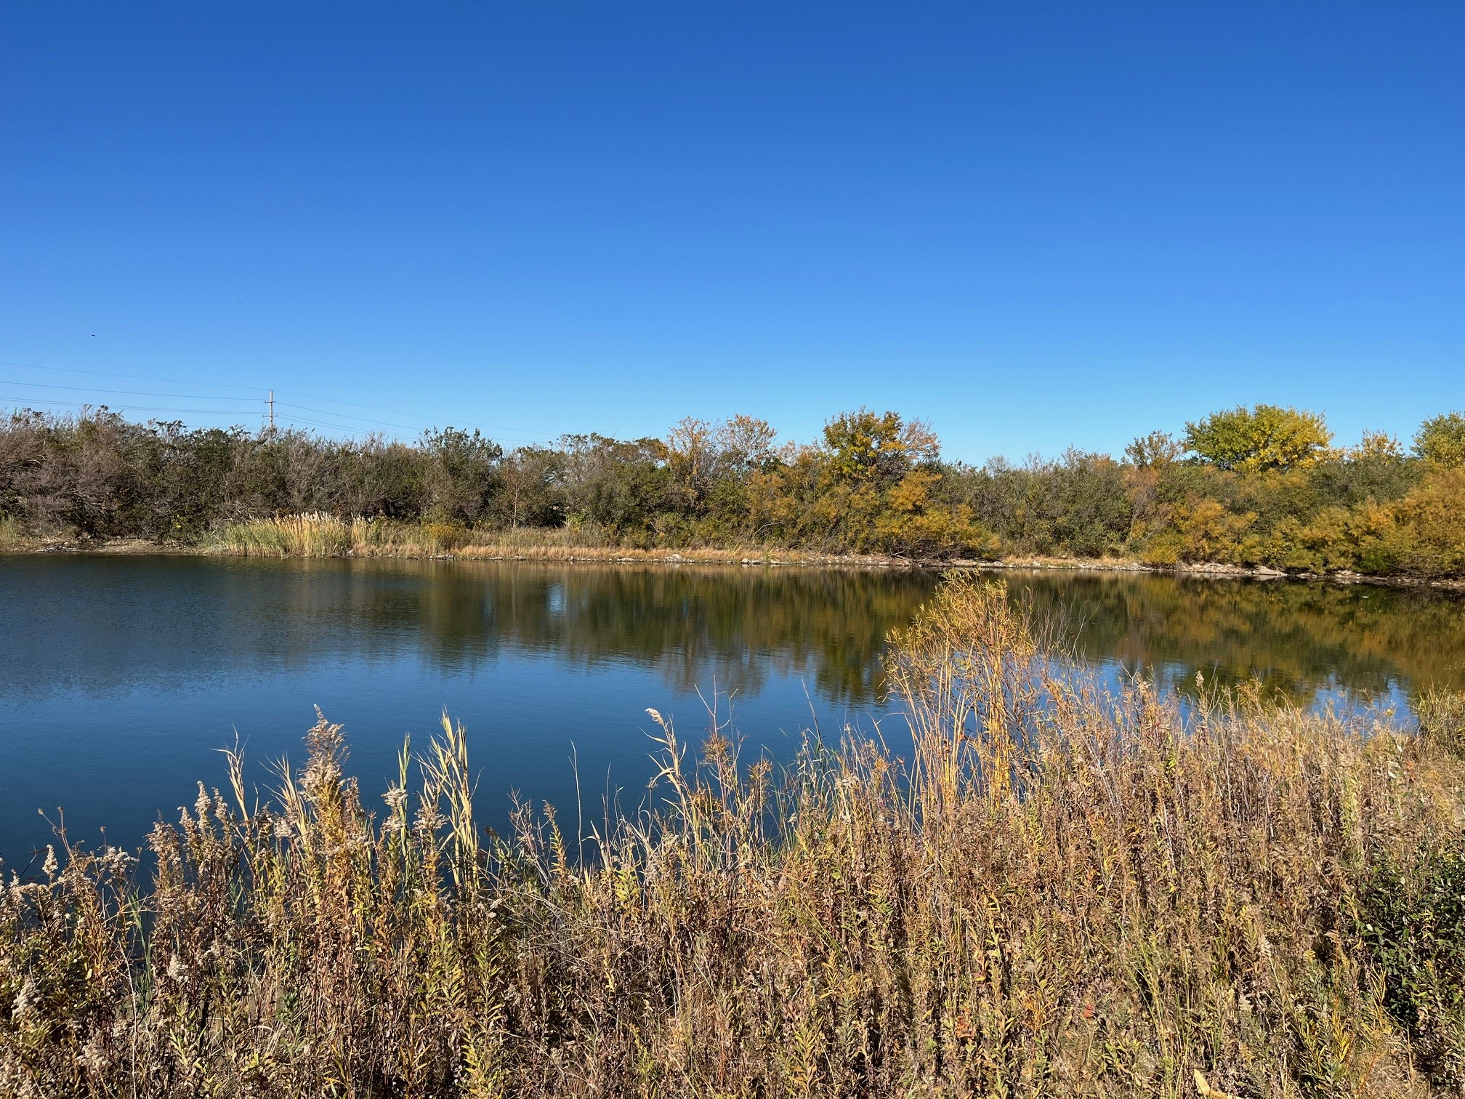


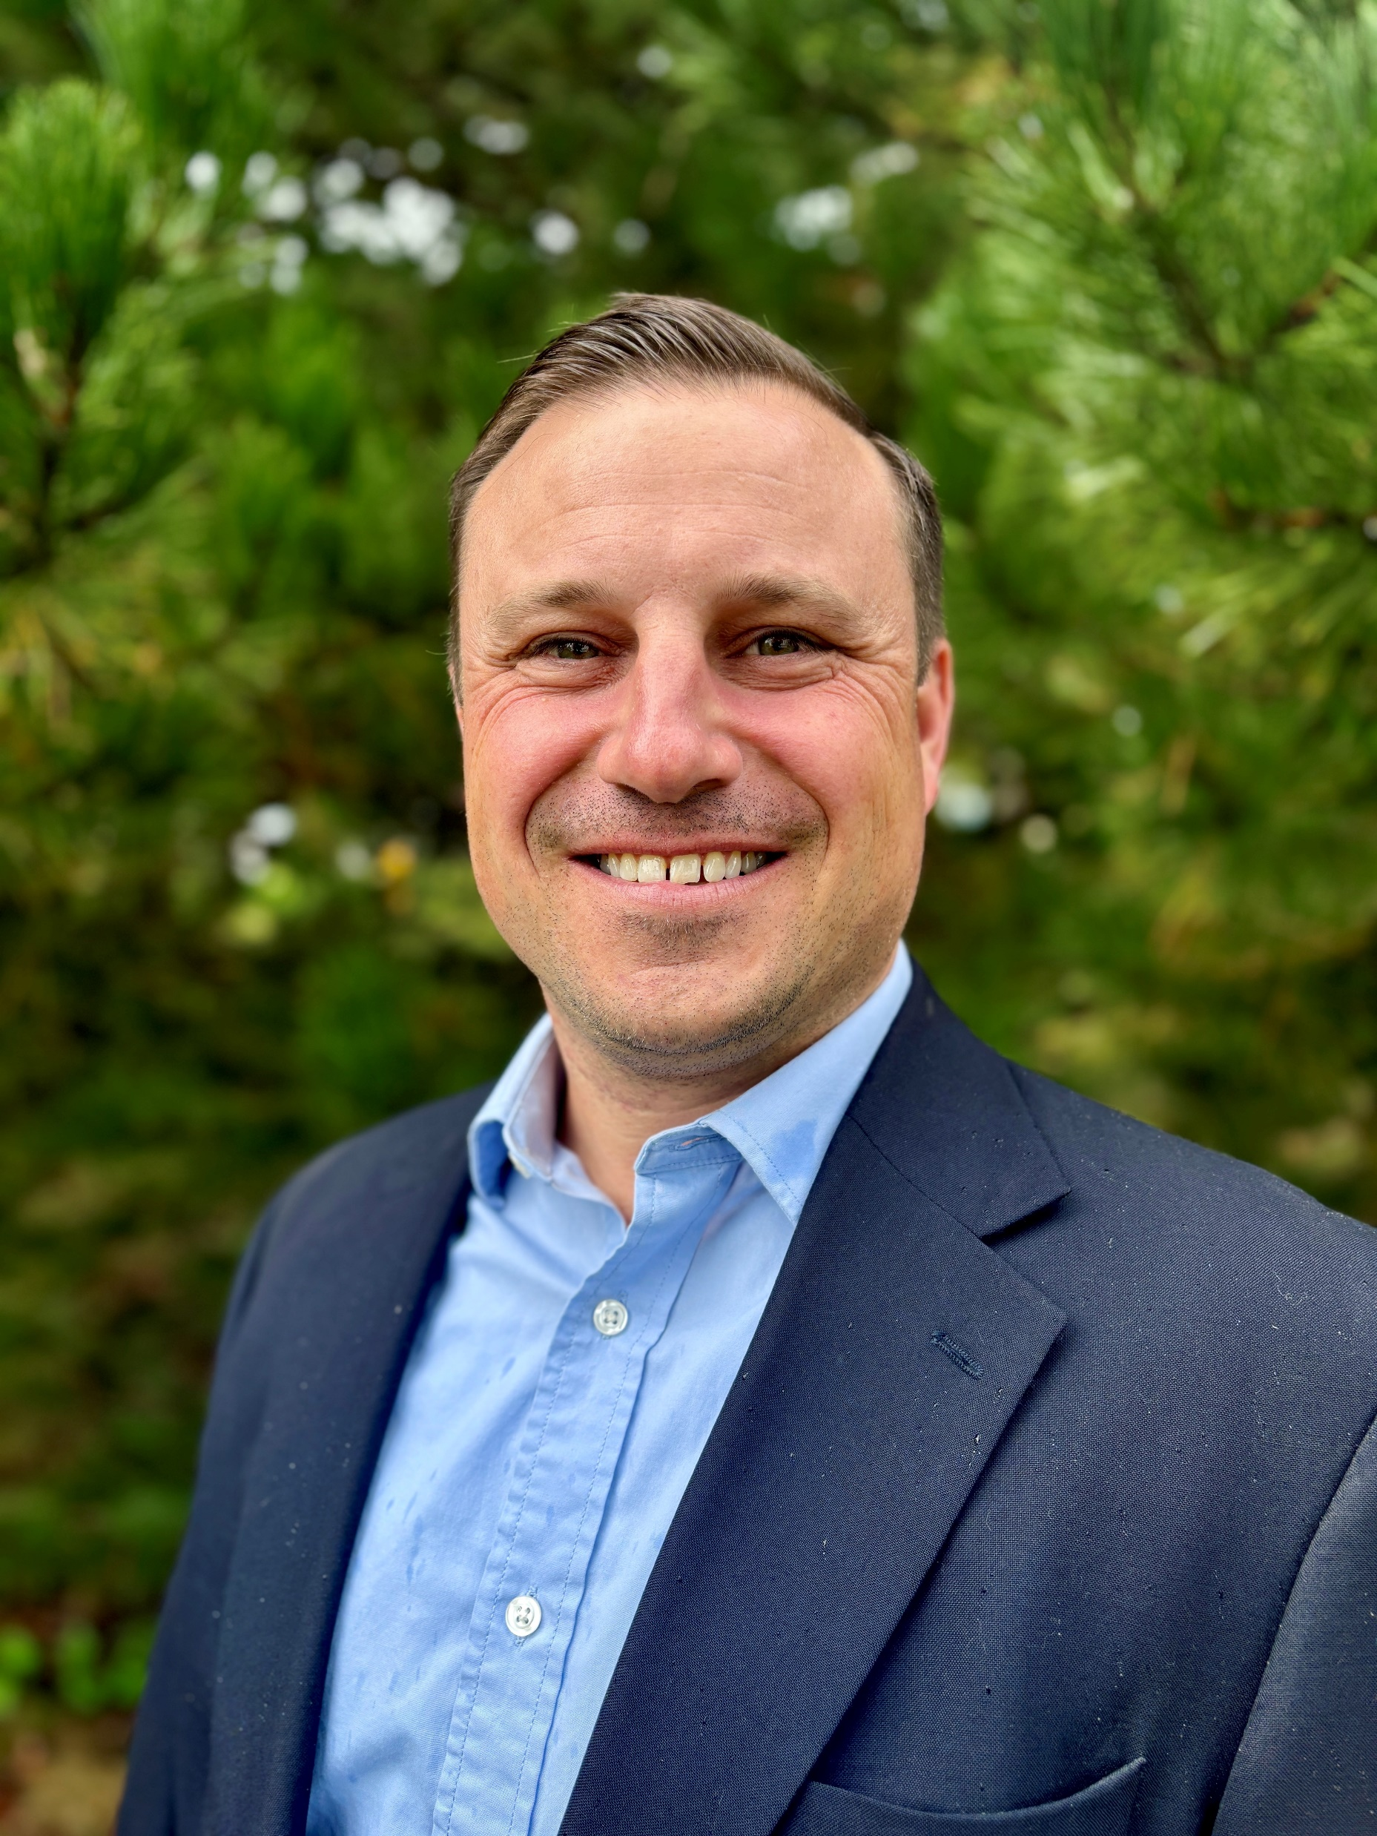
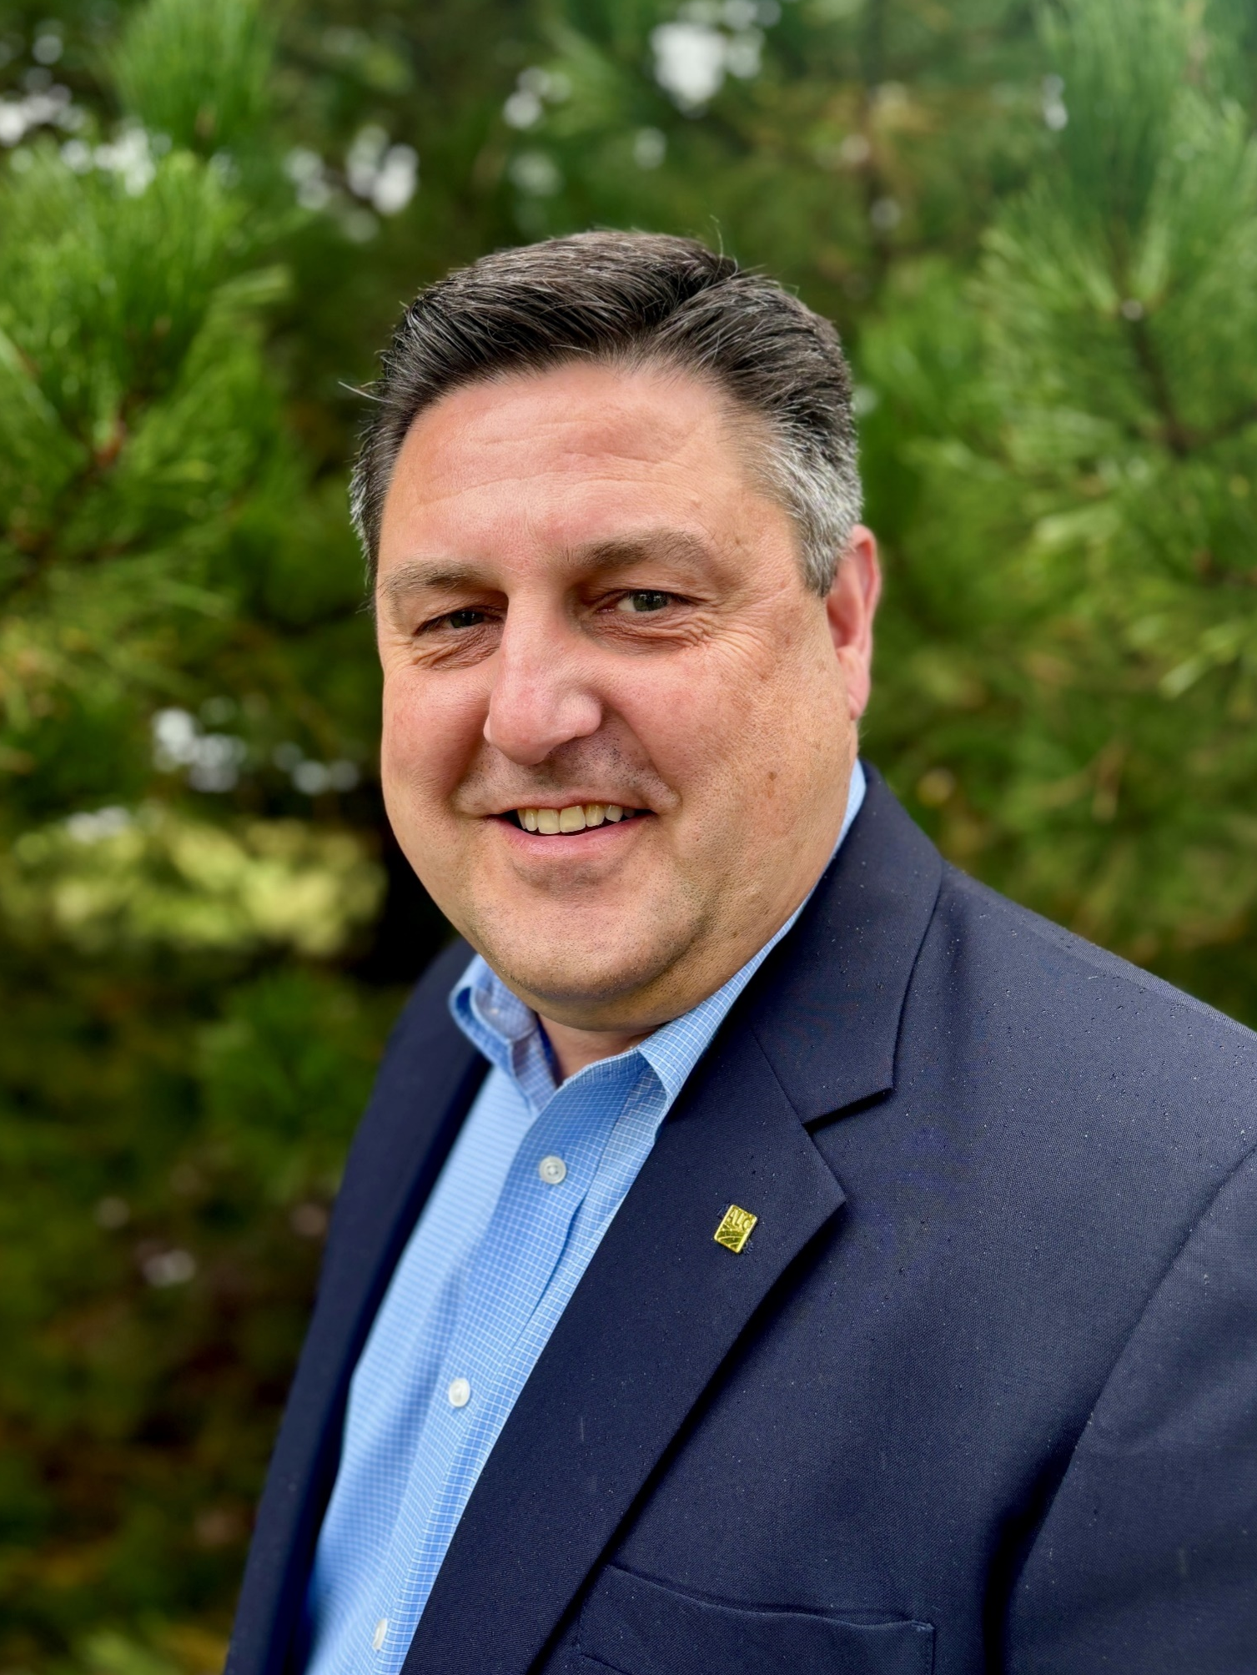


The Goodfarm Road Pond
Recreational Land for Sale
6.947 +/- Surveyed Acres | 1 Tract
Grundy County | Garfield Township
Sealed Bids due December 17th
Craig Thompson | Broker
309-665-0048
crthompson@firstmid.com
#6 Heartland Drive Ste A Bloomington, IL 61704
Des. Managing Broker |
David Klein
800-532-5263 dklein@firstmid.com
#6 Heartland Drive Ste A Bloomington, IL 61704
Lic. 471.000414
Appraisals | Auctions | Brokerage | Crop Insurance | Farm Management

Slide 2
The Goodfarm Road Pond| Grundy County | Land for Sale
General Information
METHOD OF
SALE: Request for Sealed Bids
DESCRIBED That part of Section 19, Township 31 North, Range 8 East of the Third Principal Meridian,
AS: Garfield township, Grundy County, Illinois lying southeasterly of Interstate 55 right of way and railroad right of way described as follows:
Beginning at the northwest corner of the northeast quarter of said Section 19; thence North 88 degrees 05 minutes 27 seconds East along the north line of said northeast quarter, a distance of 954.15 feet to a point on the northerly right of way line of Goodfarm road; thence South 01 degrees 54 minutes 58 seconds East along the northerly right of way line of Goodfarm road and the extension thereof, a distance of 83.35 feet to a point on the centerline of Goodfarm road; thence southwesterly along the centerline of Goodfarm road, a distance of 11.78 feet along a curve to the left having a radius of 1145.92 feet, with a chord bearing South 65 degrees 49 minutes 35 seconds West and a chord distance of 11.78 feet; thence South 65 degrees 31 minutes 55 seconds West along said centerline, a distance of 438.90 feet to a point of curvature; thence southwesterly along said centerline, a distance of 760.00 feet along a curve to the right with a chord bearing South 84 degrees 31 minutes 55 seconds West and a chord distance of 746.15 feet; thence North 76 degrees 28 minutes 04 seconds West along said centerline, a distance of 110.26 feet to a point on the southeasterly railroad right of way line; thence North 43 degrees 31 minutes 55 seconds East on the southeasterly railroad right of way line, a distance of 389.29 feet to a point on the North line of the northwest quarter of said Section 19; thence North 88 degrees 04 minutes 38 seconds East along the North line of said northwest quarter, a distance of 35.65 feet to the point of beginning.
LOCATION: 2 miles southwest of Gardner, Illinois
Adjacent to Goodfarm Road and Interstate-55
Approximately 80 miles Southwest of “The Loop” Chicago, IL
SALE Parcel is offered as a single tract. Interested parties are required to submit a sealed bid on
METHOD: the Broker provided bid form within this packet. Bids are due to broker on or before
December 17, 2024 at 11:00 am CST. The Seller reserves the right to reject any and all bids. All bidders will be notified by December 18, 2024 of the status of their offer.
AGENCY: Craig Thompson, Broker, and David Klein, Designated Managing Broker, are designated agents with First Mid Ag Services, a Division of First Mid Wealth Management and represent only the Seller in this transaction.
ATTORNEY
FOR SELLER: Nicholas Ehrgott
Caughey, Legner, Freehill, Ehrgott & Mann
204 N. Main Street
Pontiac, IL 61764
Disclosures and Disclaimer: The information provided is believed to be accurate and representative. The property is being sold on an “AS IS, WHERE IS” basis, and no warranty or representation, either express or implied, concerning the property is made by the Seller or the real estate company. All information contained in all related materials is subject to the terms and conditions outlined in the purchase agreement. Each potential buyer(s) is responsible for conducting his/her own independent inspections, investigations, inquiries, and due diligence concerning the property. The information contained here is believed to be accurate but is subject to verification by all parties relying on it. All sketches and dimensions are approximate. Seller and Seller’s agent disclaim any and all responsibility for buyer(s) safety during any physical inspection of the property. No party shall be deemed an invitee of the property by virtue of the offering of this property for sale.
Bloomington | Decatur | Kankakee Mattoon | Peoria | Springfield
www.firstmidag.com

Slide 3
The Goodfarm Road Pond | Grundy County | Land for Sale
Terms & Conditions
CONTRACT: A successful bidder’s 10% downpayment will be due with a signed contract on or before 11:00 AM December 19, 2024. The remaining amount of the purchase price will be due at closing on or before January 17, 2025. All inspection fees are the sole responsibility of the Buyer. All property will be sold “as is”.
TITLE: The Seller will provide to the Buyer a commitment and an Owners Title Guaranty Policy issued by a Company licensed to issue the same in the State of Illinois for the amount the purchase.
FINANCING: Bidding is not conditional upon financing, or any buyer or lender inspections. Be certain you have arranged financing, if needed, and are capable of paying cash at closing.
LEASE & The property is free of lease. Possession will be granted to the Buyer at
POSSESSION: closing.
MINERAL
RIGHTS: The owner’s remaining interest, if any, will be conveyed with the land.
REAL ESTATE
TAXES: The 2024 real estate taxes, special assessments due in 2025 shall be paid by the Seller. Buyer is responsible for 2025 and all future real estate taxes. The property is part of Grundy County parcel 12-19-200-003. The parcel will be split after the sale is completed. The taxing bodies include Gardner School District, Gardner Fire, Joliet Jr College, Garfield Twp, and Fossil Ridge Library.
Bloomington | Decatur | Kankakee Mattoon | Peoria | Springfield
www.firstmidag.com

Slide 4
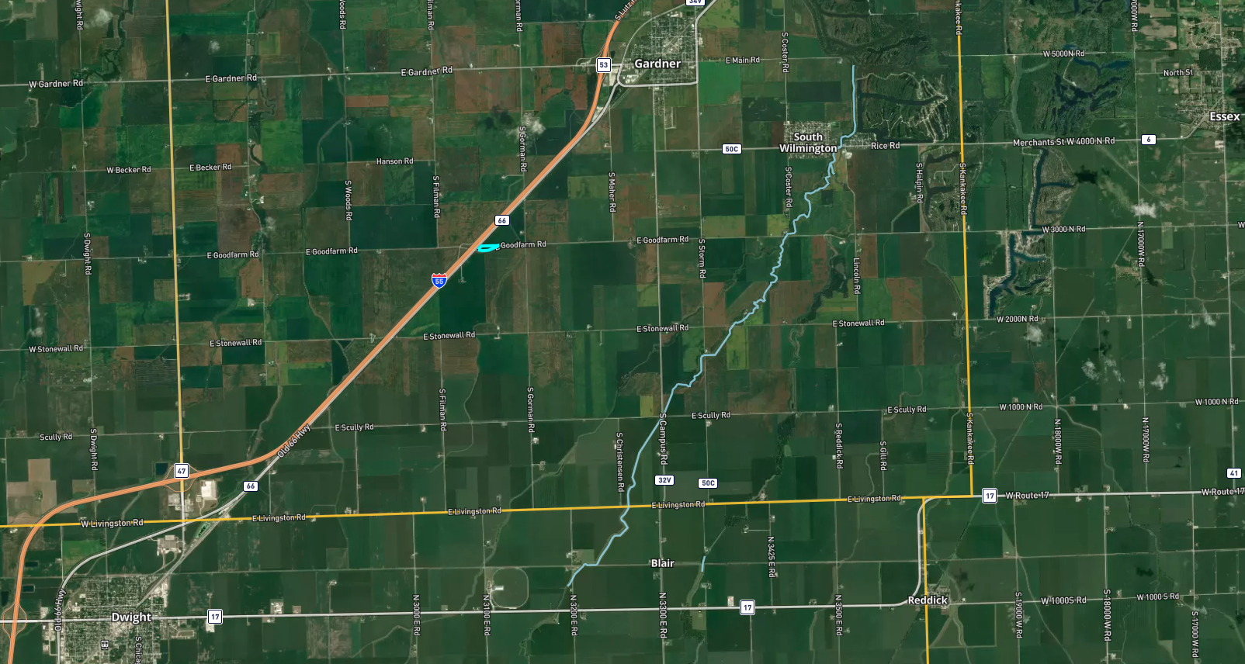


The Goodfarm Road Pond | Grundy County | Land for Sale
Area Maps
Gardner
Deland Monticello Rd
FOR SALE
Goodfarm Road
S Market St
Tract 1
Tract 2
Dwight
E 1100 N Rd
Tract 3
Ivesdale
Physical Address: Latitude: 41.155368
3700 E Goodfarm Rd Longitude: -88.347431
Gardner, IL 60424
N 1000 E Rd
Bement
Bloomington | Decatur | Kankakee Mattoon | Peoria | Springfield
www.firstmidag.com

Slide 5
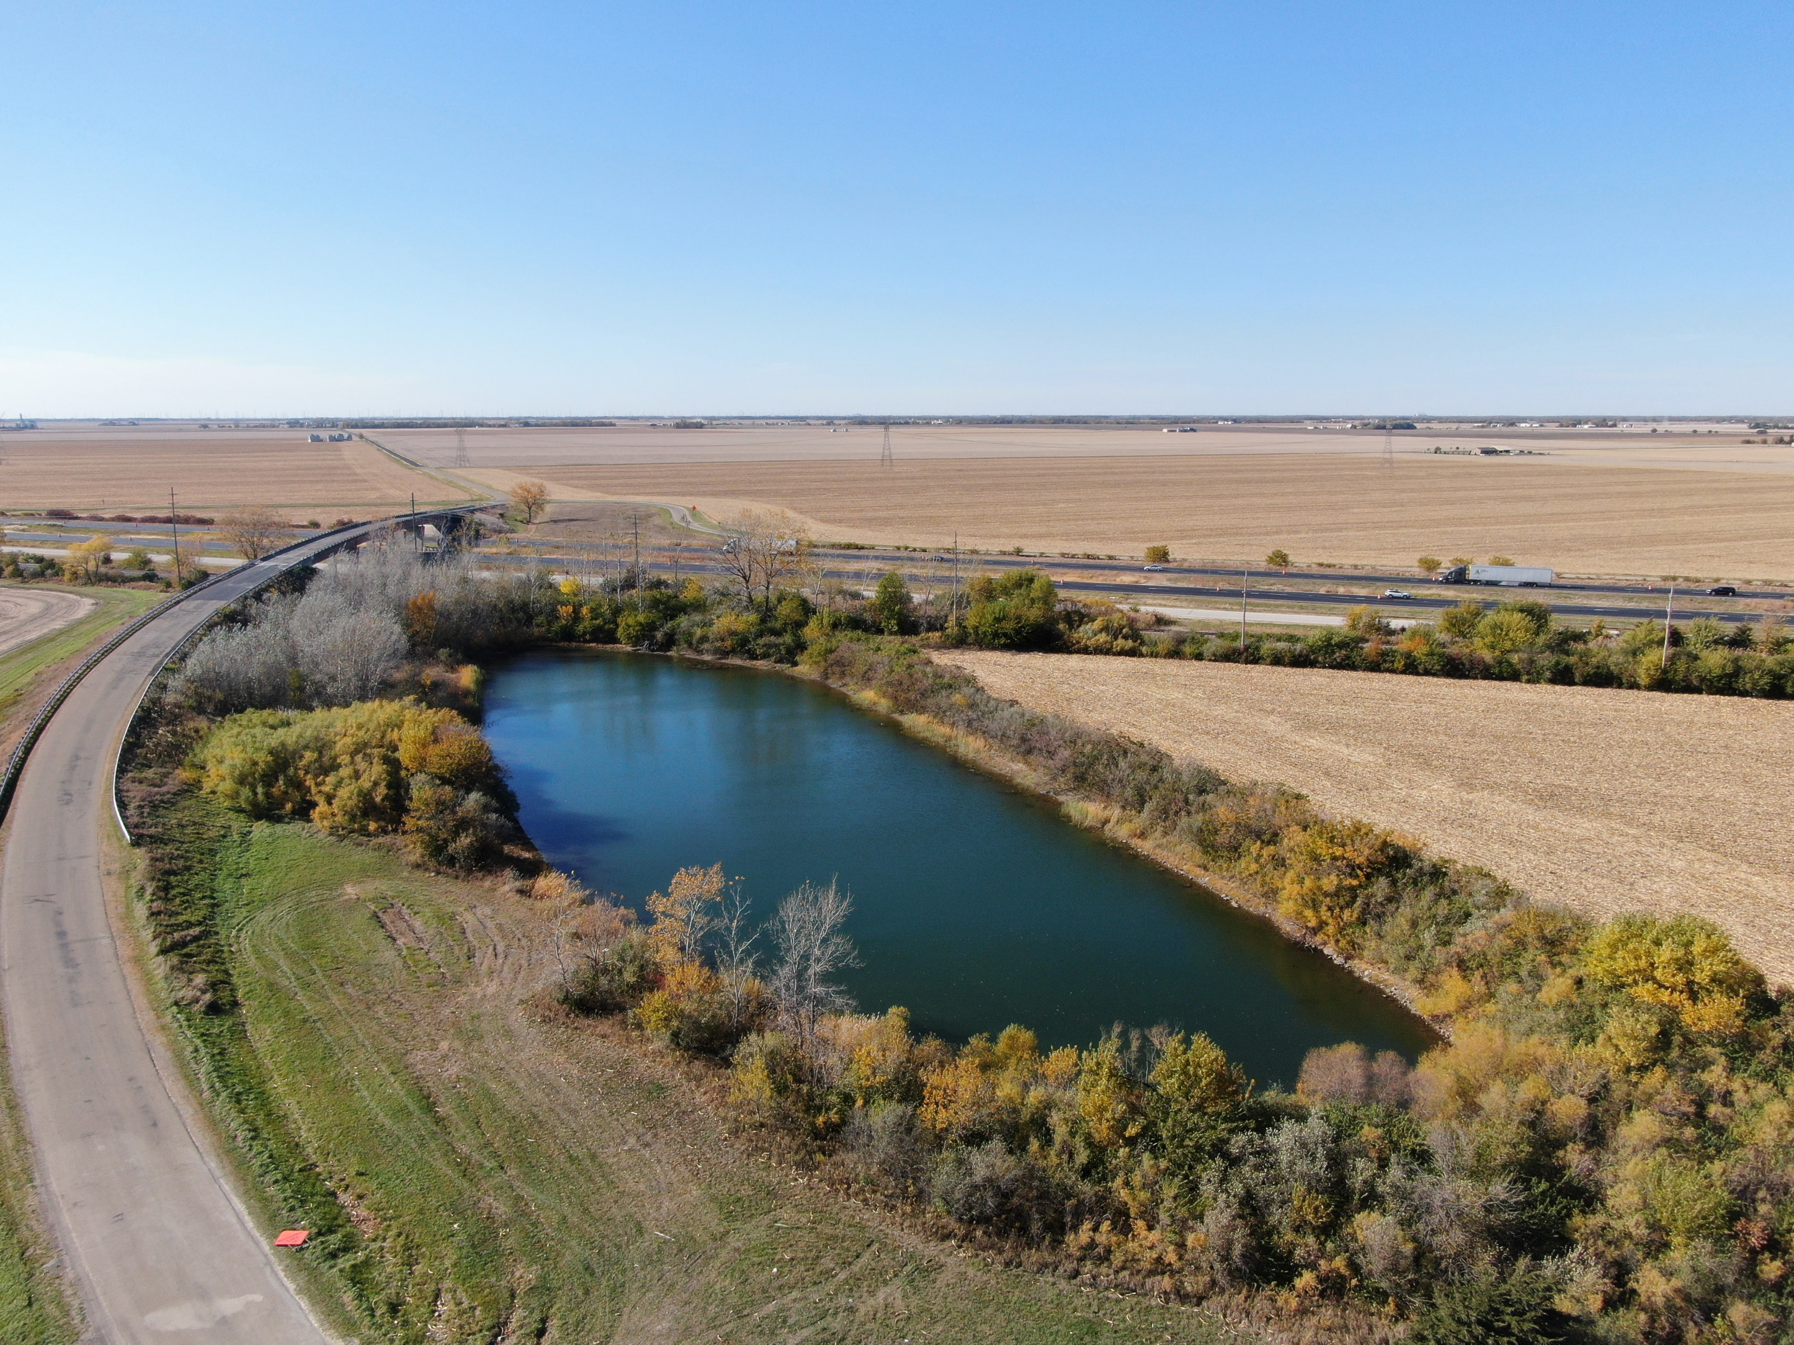
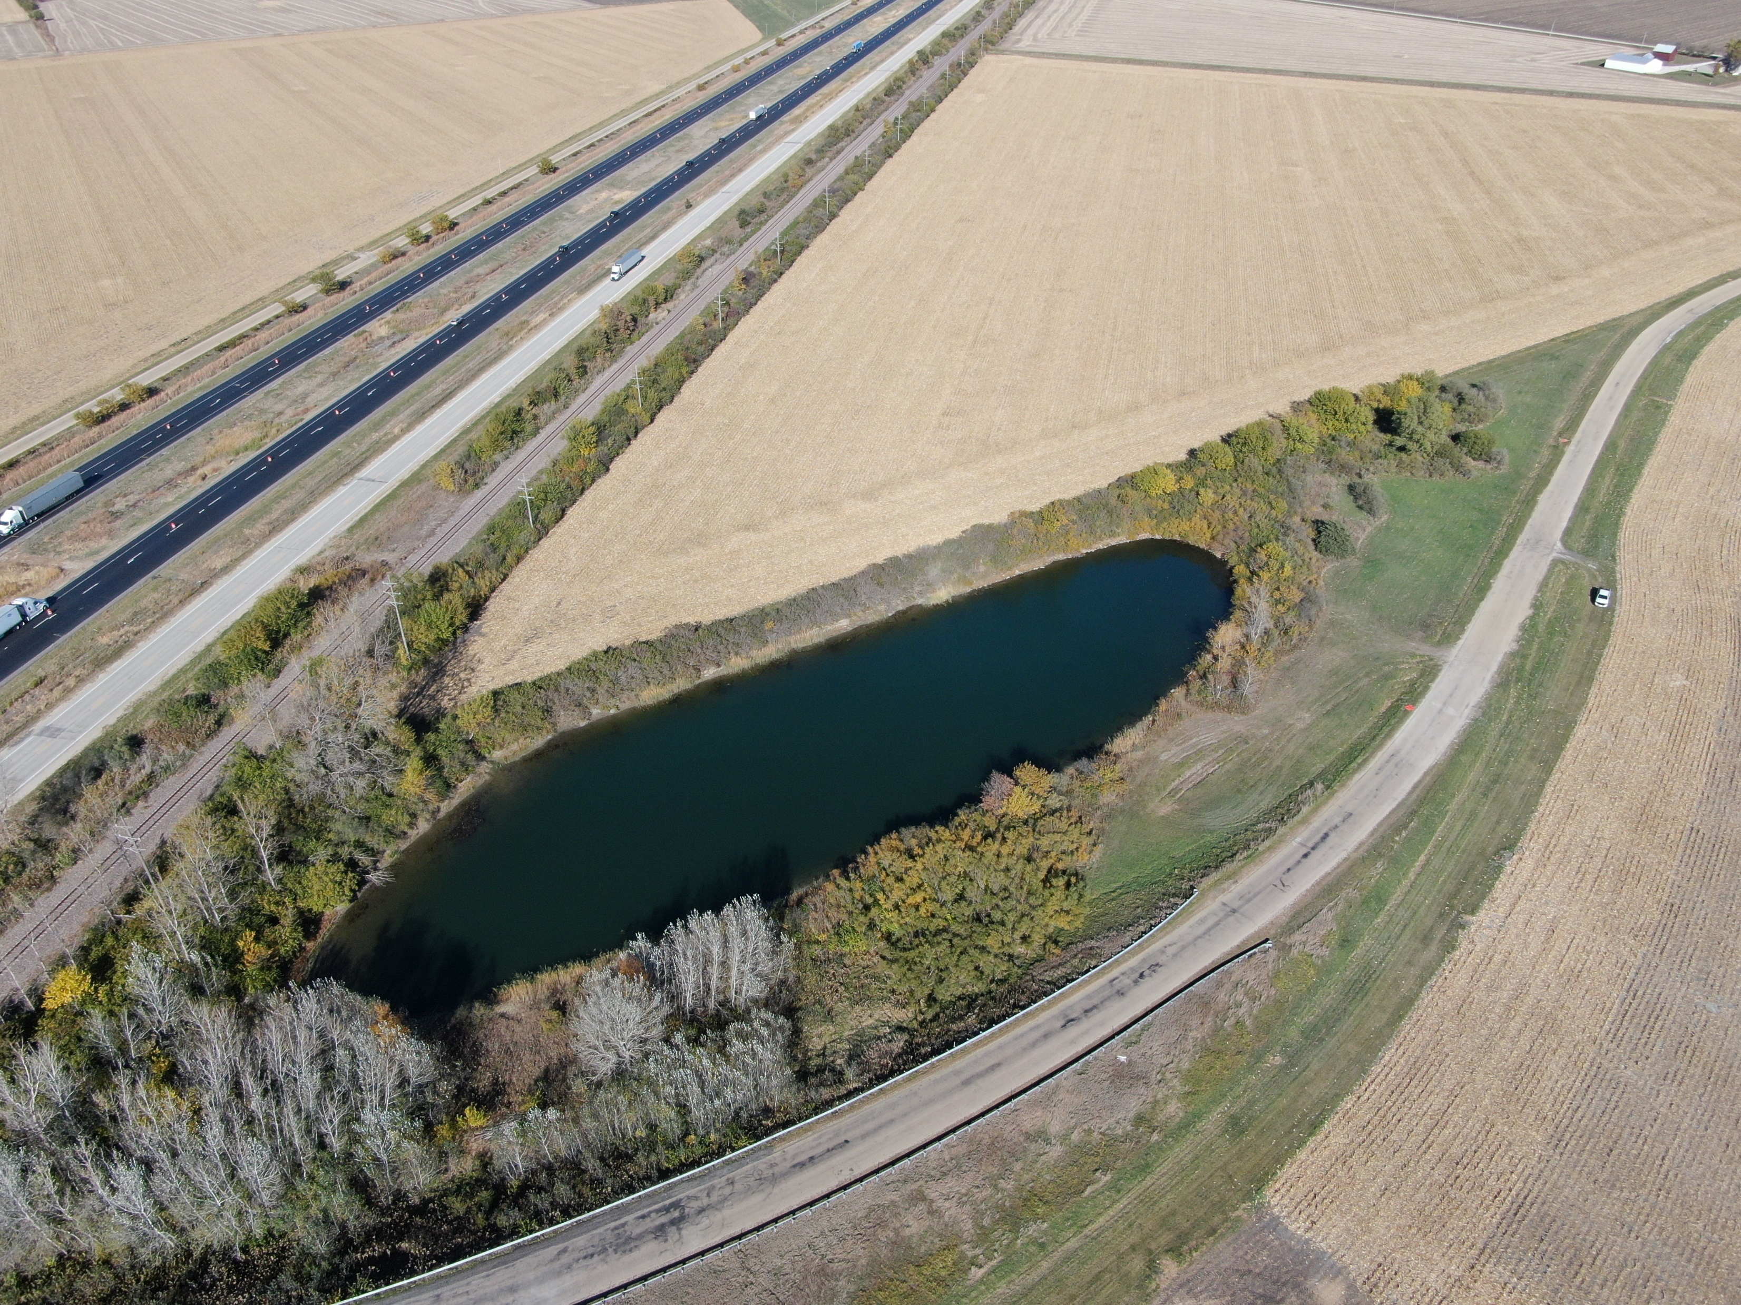
The Goodfarm Road Pond | Grundy County | Land for Sale
Photos
Bloomington | Decatur | Kankakee Mattoon | Peoria | Springfield
www.firstmidag.com

Slide 6
The Goodfarm Road Pond | Grundy County | Land for Sale
Bid Sheet
GOODFARM ROAD POND
SEALED BIDS DUE
TUESDAY DECEMBER 17, 2024
11:00 A.M. C.S.T. to FIRST MID AG - BLOOMINGTON
BID SHEET
I wish to place the following bid on the Goodfarm Road Pond and agree to abide by the terms of sale provided herein.
I understand that I will be required to sign a contract at this bid price if I am the successful bidder. I will present a 10% downpayment by cashier’s check or wire transfer made payable to 1954 T/U/W Peter D. Scully to be held by First Mid Ag Services if I am the successful bidder.
ENTIRE PROPERTY
TOTAL CONSIDERATION: $
Thousand Dollars
NAME: ___________________________________
ADDRESS: ___________________________________
CITY/STATE: ___________________________________
PHONE NO: ___________________________________
EMAIL: ________________________________________
SIGNATURE: DATE:
Bids may be presented or mailed to:
First Mid Ag Services, A Division of First Mid Wealth Management Company
Attn: Craig Thompson
#6 Heartland Drive, Suite A
PO Box 1607 Bloomington, IL 61702-1607 (309)-665-0955
crthompson@firstmid.com
Bloomington | Decatur | Kankakee Mattoon | Peoria | Springfield
www.firstmidag.com

Slide 7
The Goodfarm Road Pond | Grundy County | Land for Sale
SURVEY
Bloomington | Decatur | Kankakee Mattoon | Peoria | Springfield
www.firstmidag.com

Slide 8
The Goodfarm Road Pond | Grundy County | Land for Sale
PRELIMINARY TITLE COMMITTMENT
Bloomington | Decatur | Kankakee Mattoon | Peoria | Springfield
www.firstmidag.com

Slide 9
The Goodfarm Road Pond | Grundy County | Land for Sale
PURCHASE
CONTRACT
Bloomington | Decatur | Kankakee Mattoon | Peoria | Springfield
www.firstmidag.com

