Slide 1
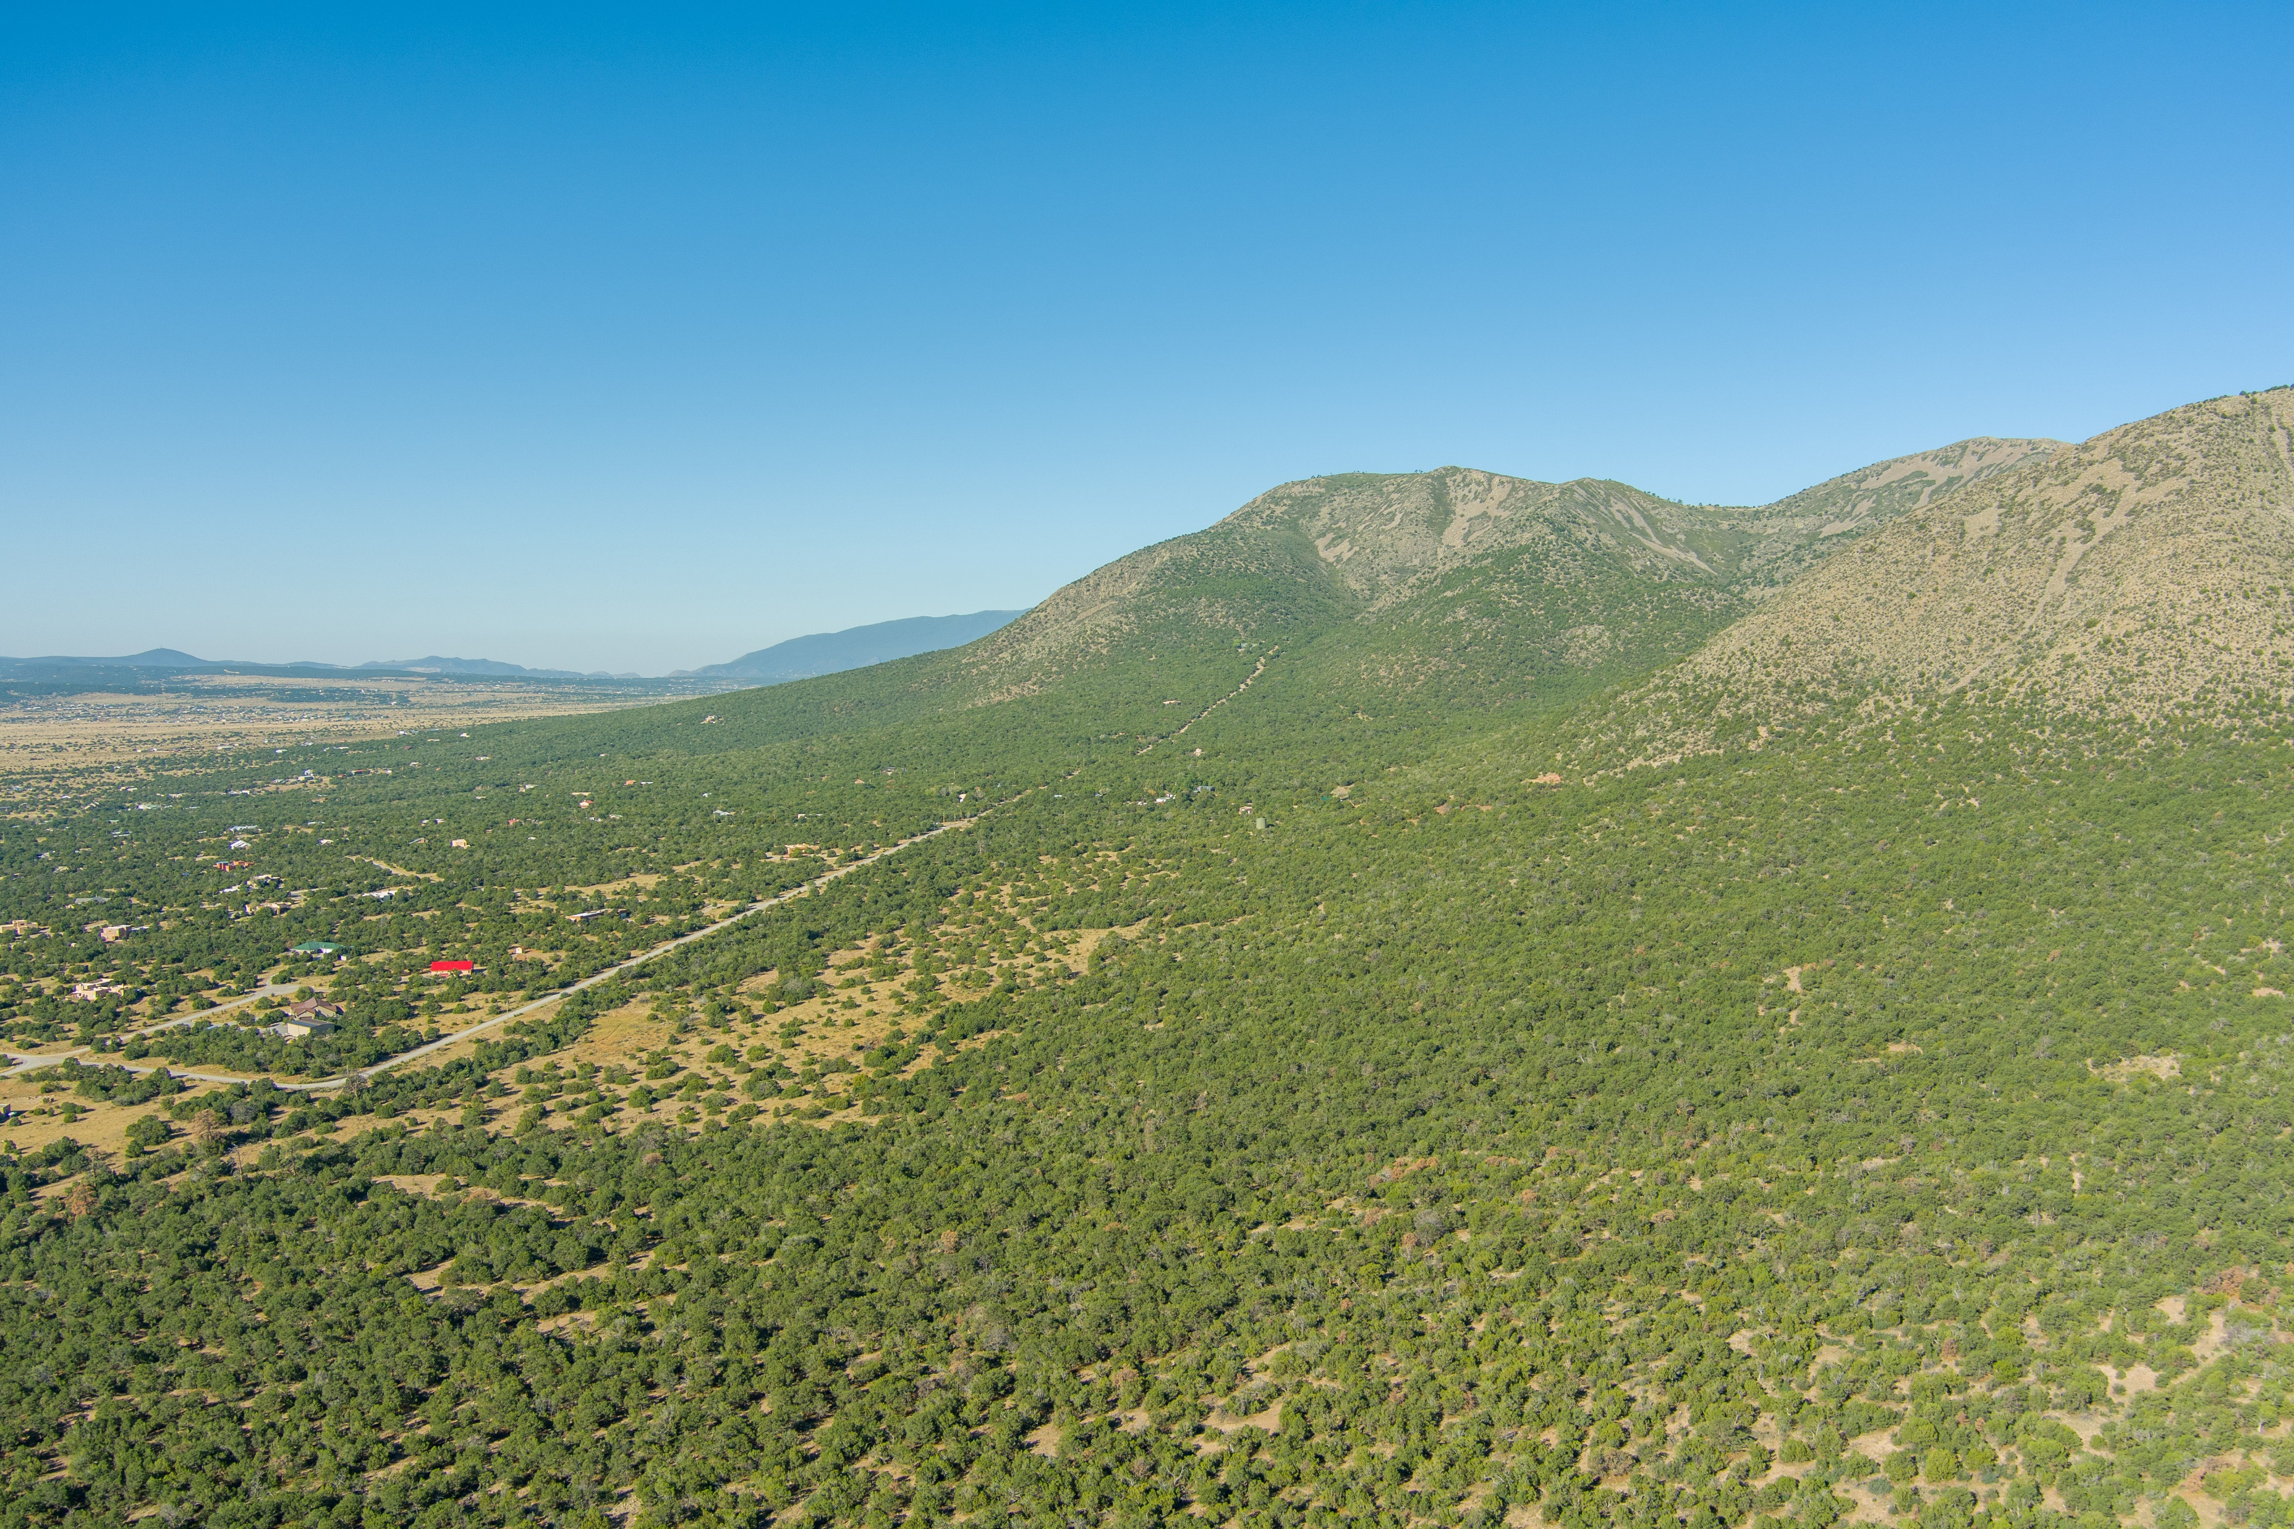
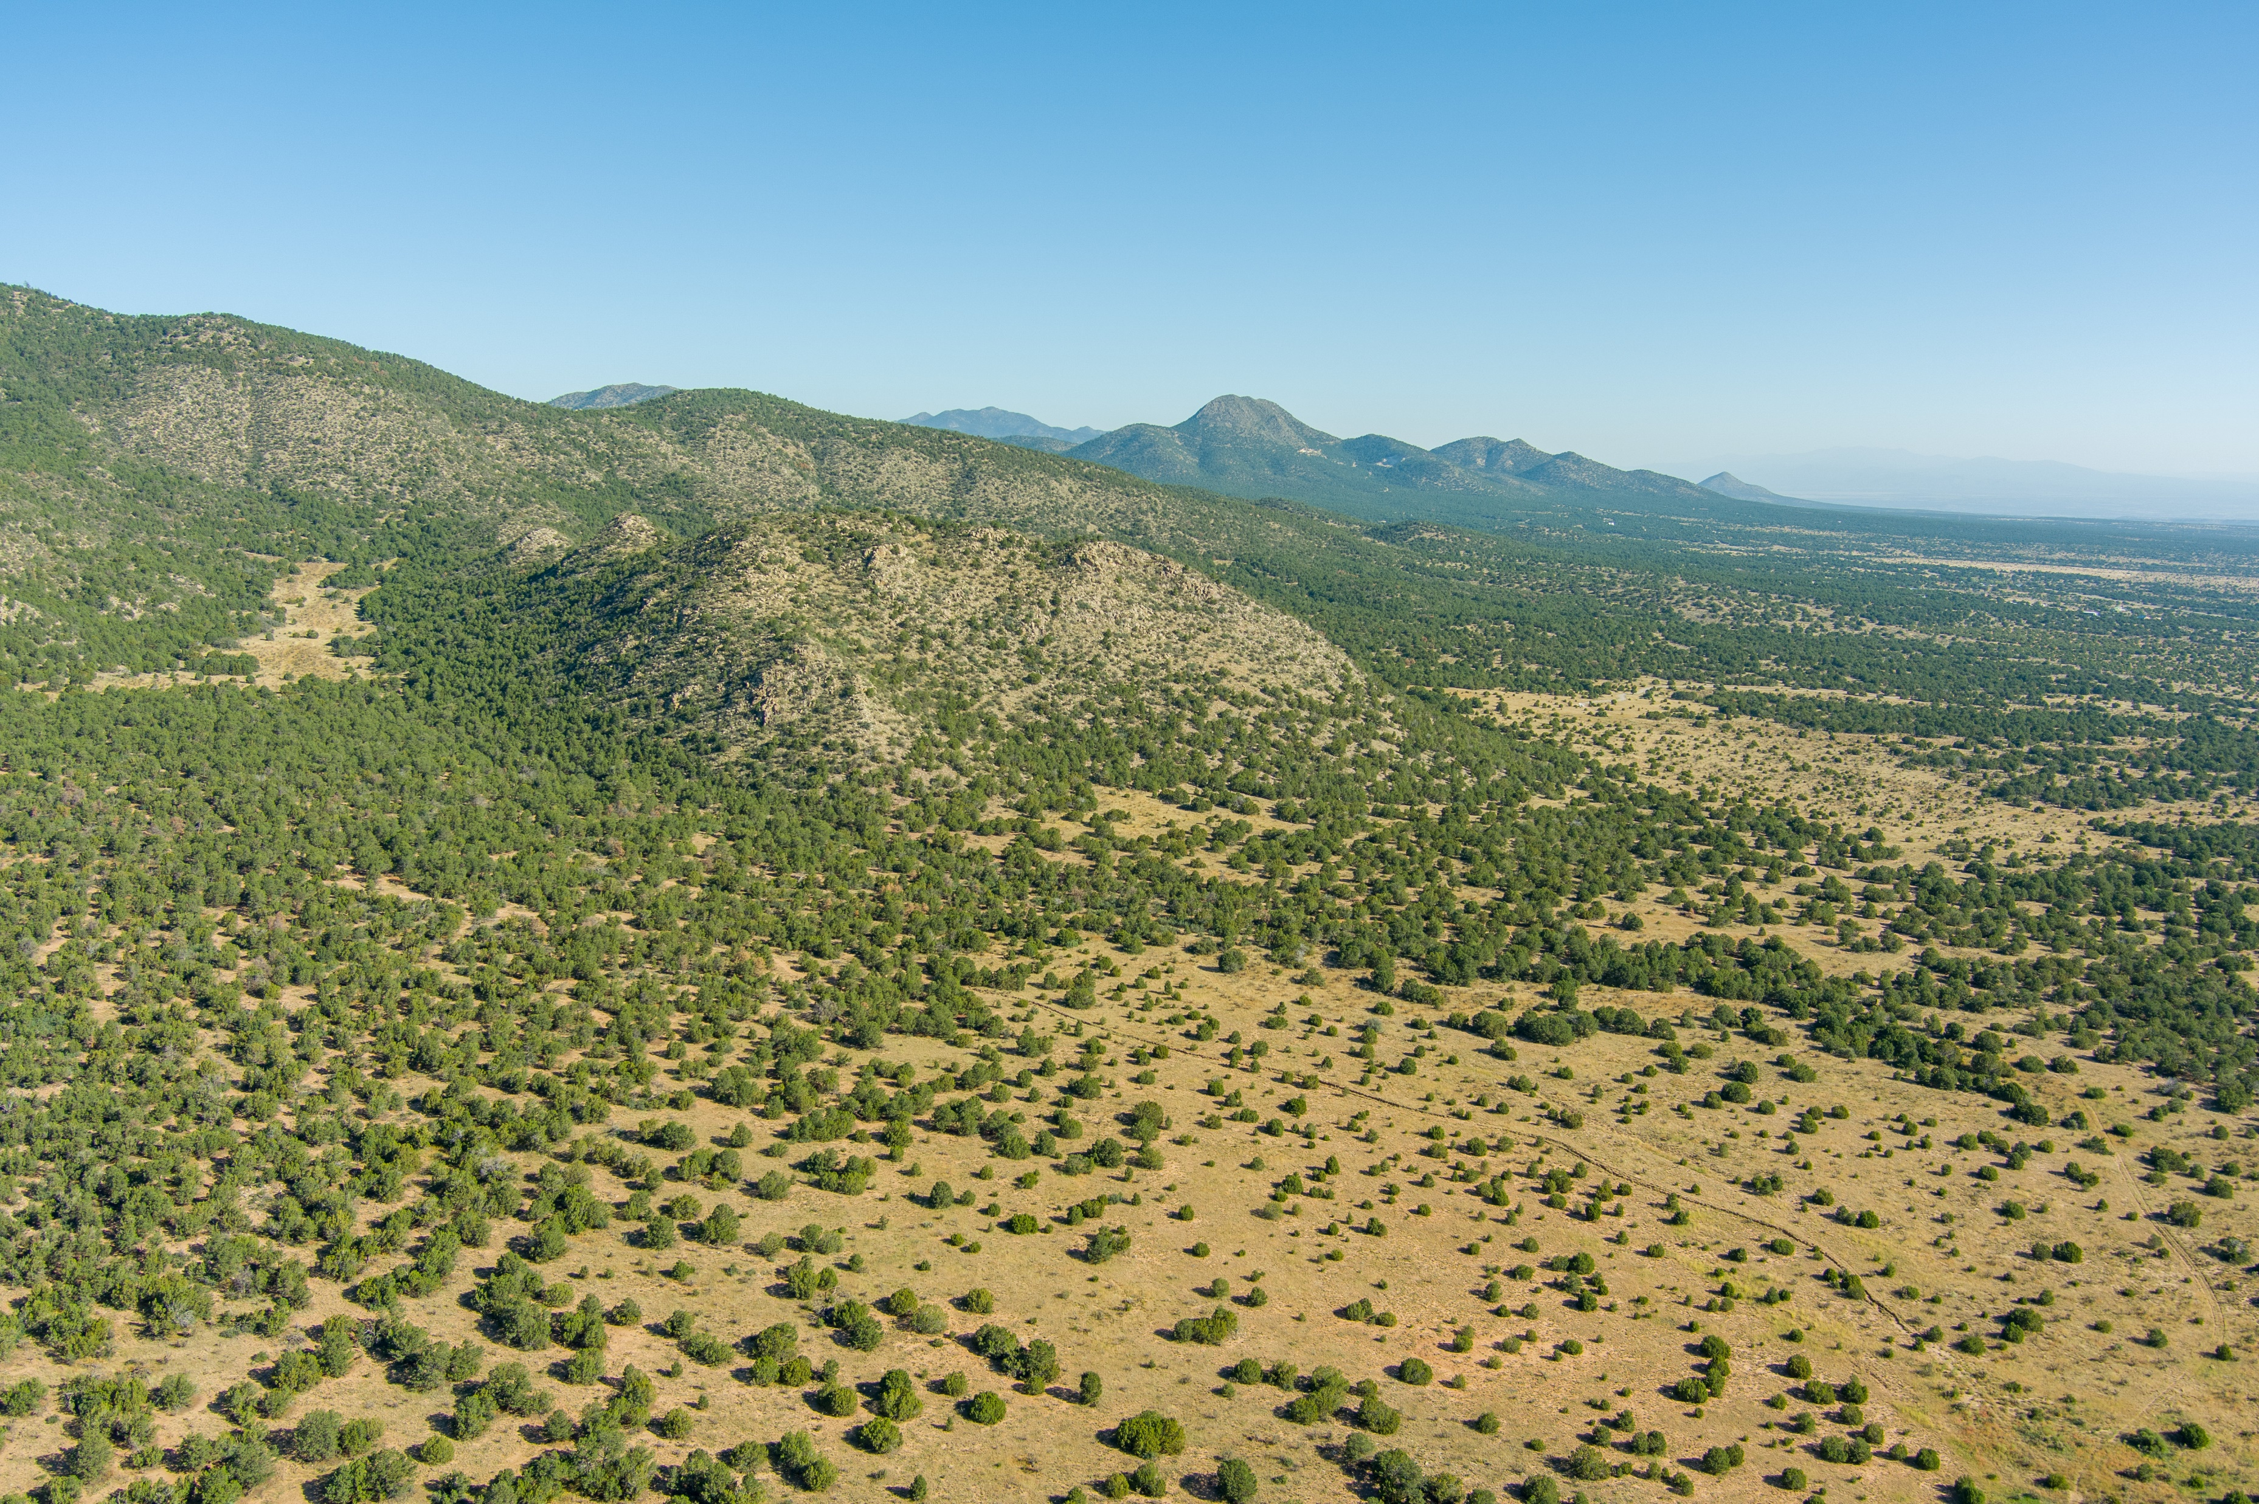
15 Camino San Pedros Road, Edgewood, NM 87015
320 Acres of Wooded Acreage
Includes 50 Acre Feet of Water Rights
$995,000
County: Santa Fe
Tax Annual Amount: $15.00
GRT Code: 01-001
Zoning: A-2
Restrictive Covenant: None
Short Legal Desc:T11N R 7E S10 Tract C and D
Utilities: Electricity Available; Natural Gas Not Available; Phone Available; Water Available;
Water Source: Community Water,
50 Acre Feet of Water Rights
Wastewater: None
Distance to Electrical: 0 - 1/4 Mile
Distance to Water: 0 - 1/4 Mile
Distance to Phone: 0 - 1/4 Mile
Distance to Cable: Call Listing Broker
Topography: Slight Slope
Features: Heavily Wooded, Horses Permitted, Portion is Meadowed, Views, Wire Fence,
Property Access: S Property Line, W Property Line

